Slide 1
Results Cyrcè 19.06.24

Slide 2
Changes in data treatment
All diodes are recorded – no excluded channels
Compared to the last measurements the channel numbering is mirrored?!
File positions are given different (clearer) as _x_..._y_....csv
new parsing of position was written
No variation in beam: Otsu‘s method for generating an on-signal and dark measurement is not available any longer
One ?! dark measurement: “d2_1n_3s_beam_all_without_diffuser_dark.csv“
General usage of dark measurement added
Normalization factor: Compare following slides
Channel 60 with extremely high noise (but no proton signal) –> reduced or not used in following

Slide 3
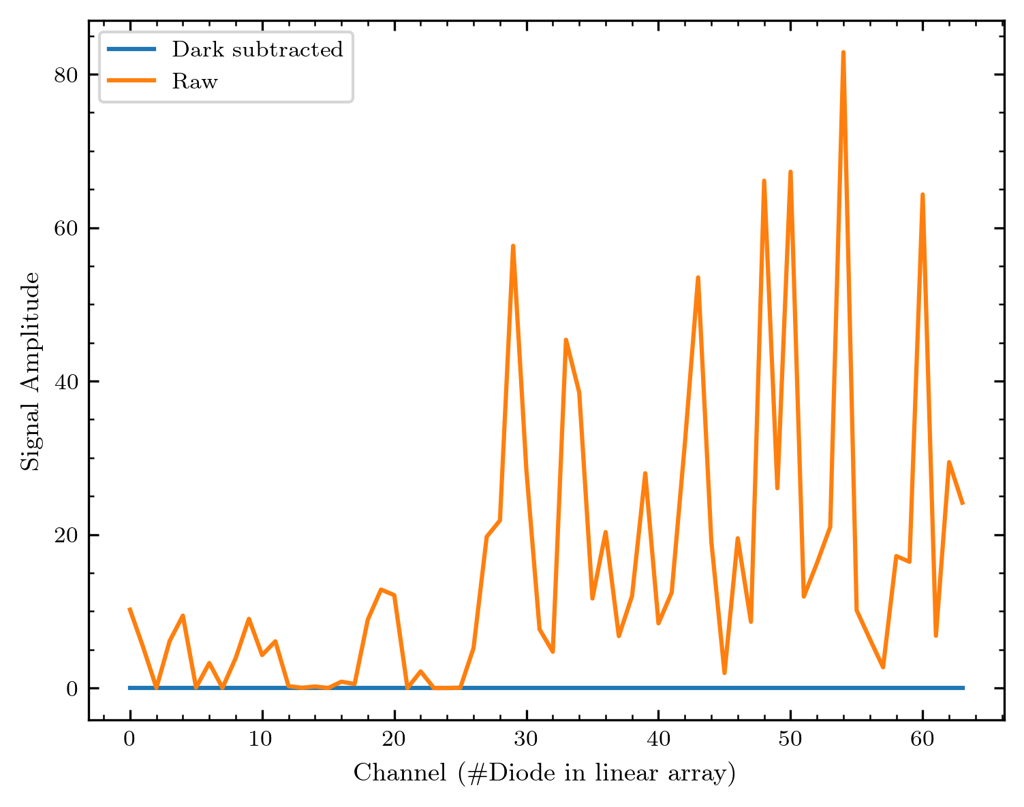
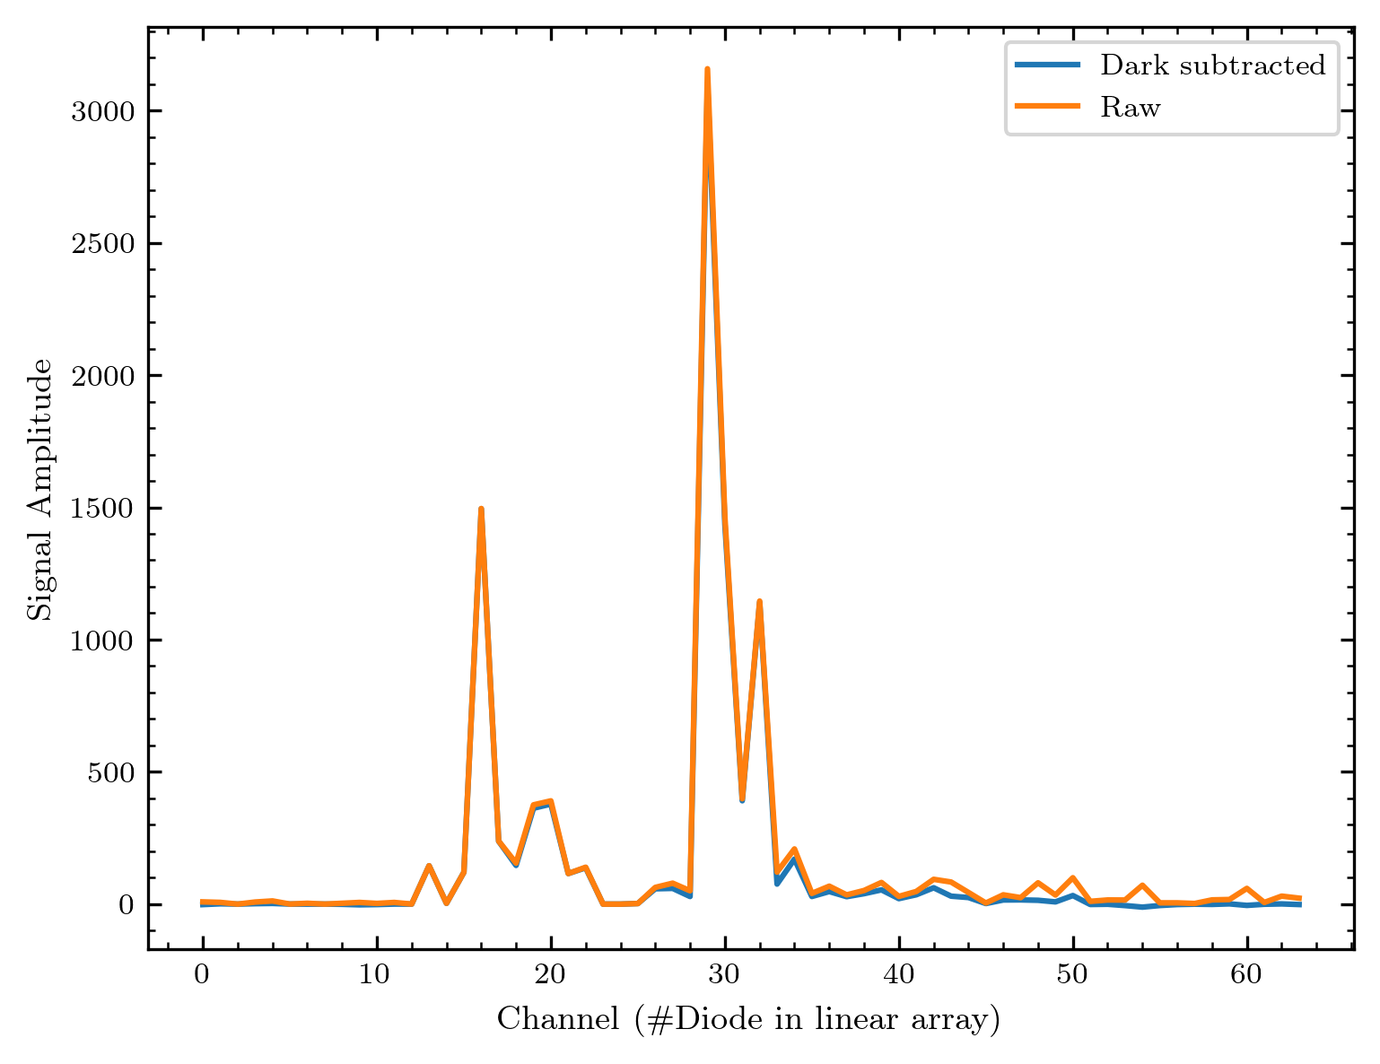
Dark measurement
Dark measurement
Applied on higher signal

Slide 4
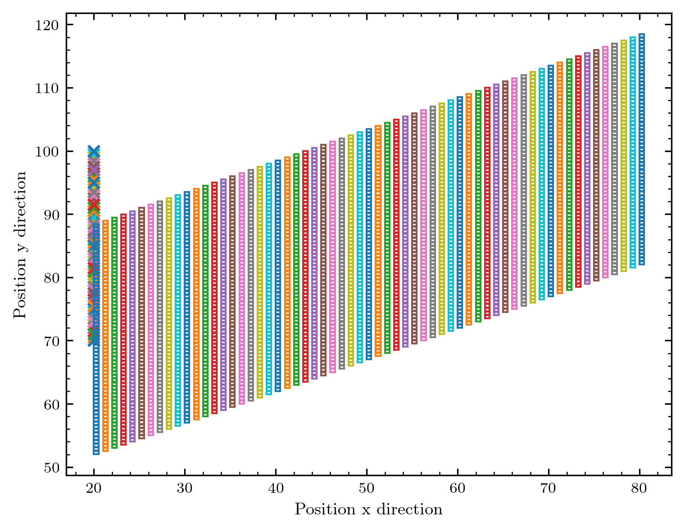
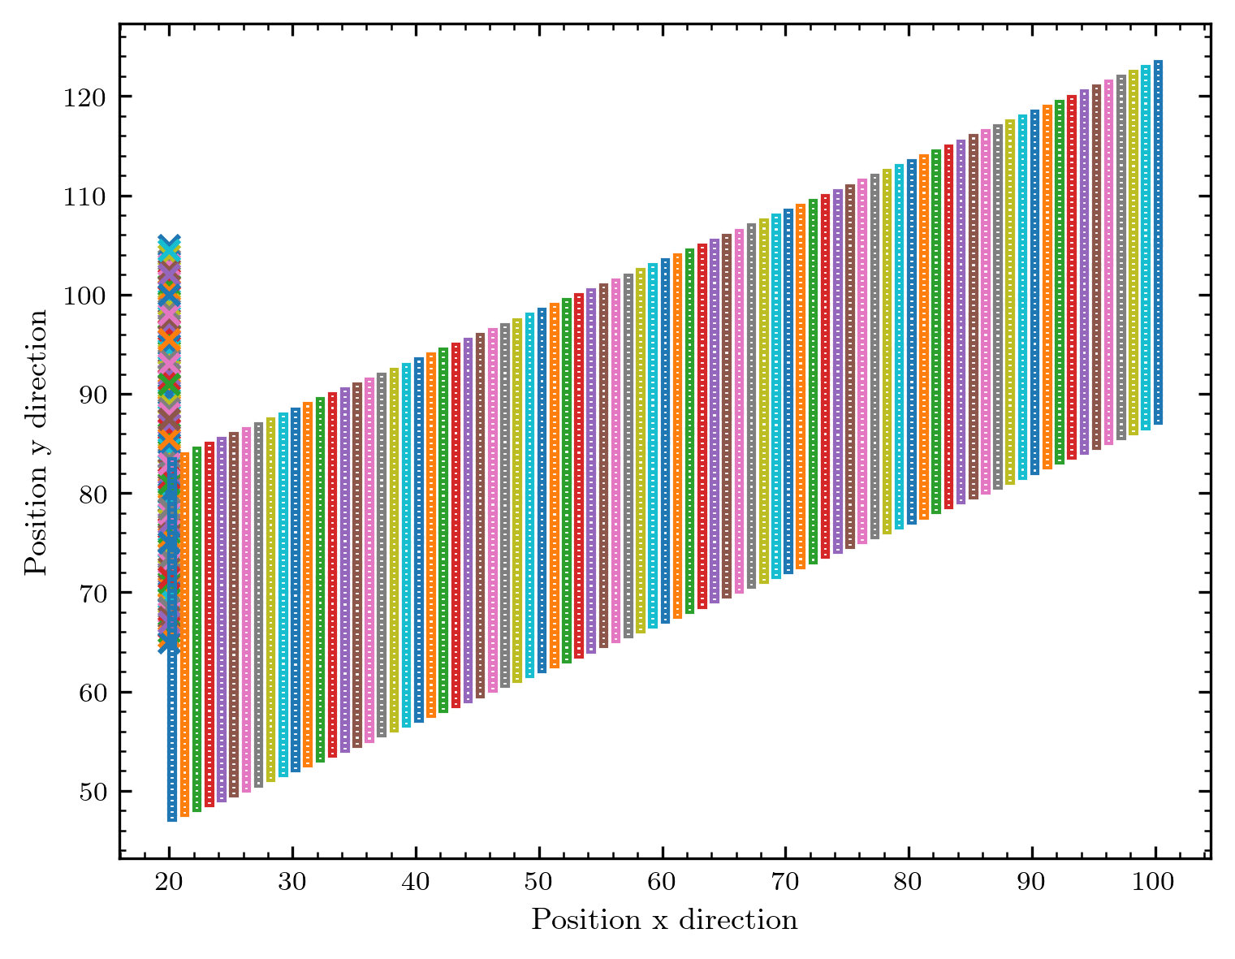
Normalization – what‘s measured?
5s_flat_calib = end of measurement day
500p_center = begin of measurement day
Note that x is intentionally shifted for better visualization
Available: 1 measurement at beginning and one at the ~ end of the measurement day – unstable beam for the first measurements on the 19.06.24

Slide 5
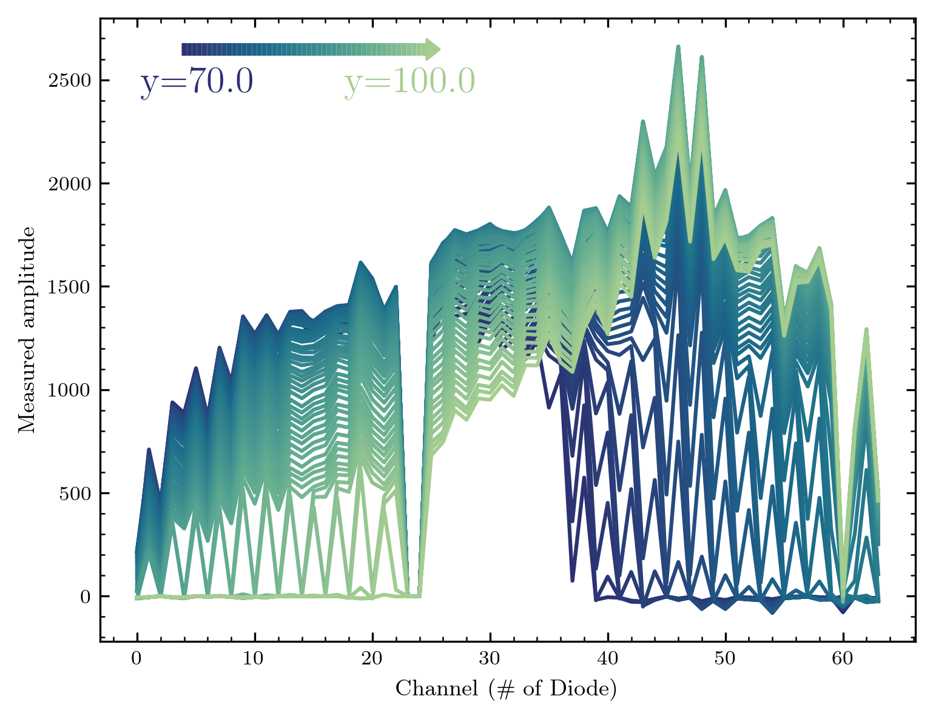
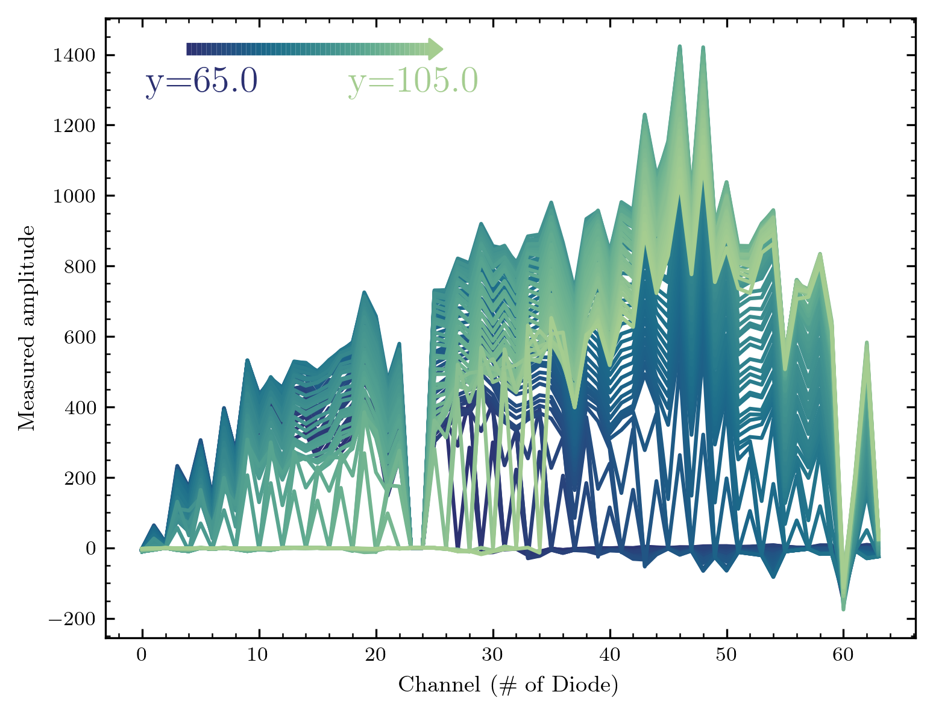
Signals of these measurements
For better visualization: Every diode corresponds with a real y-position in these measurements – calculated out of y-position and diode number considering diode size and spacing

Slide 6
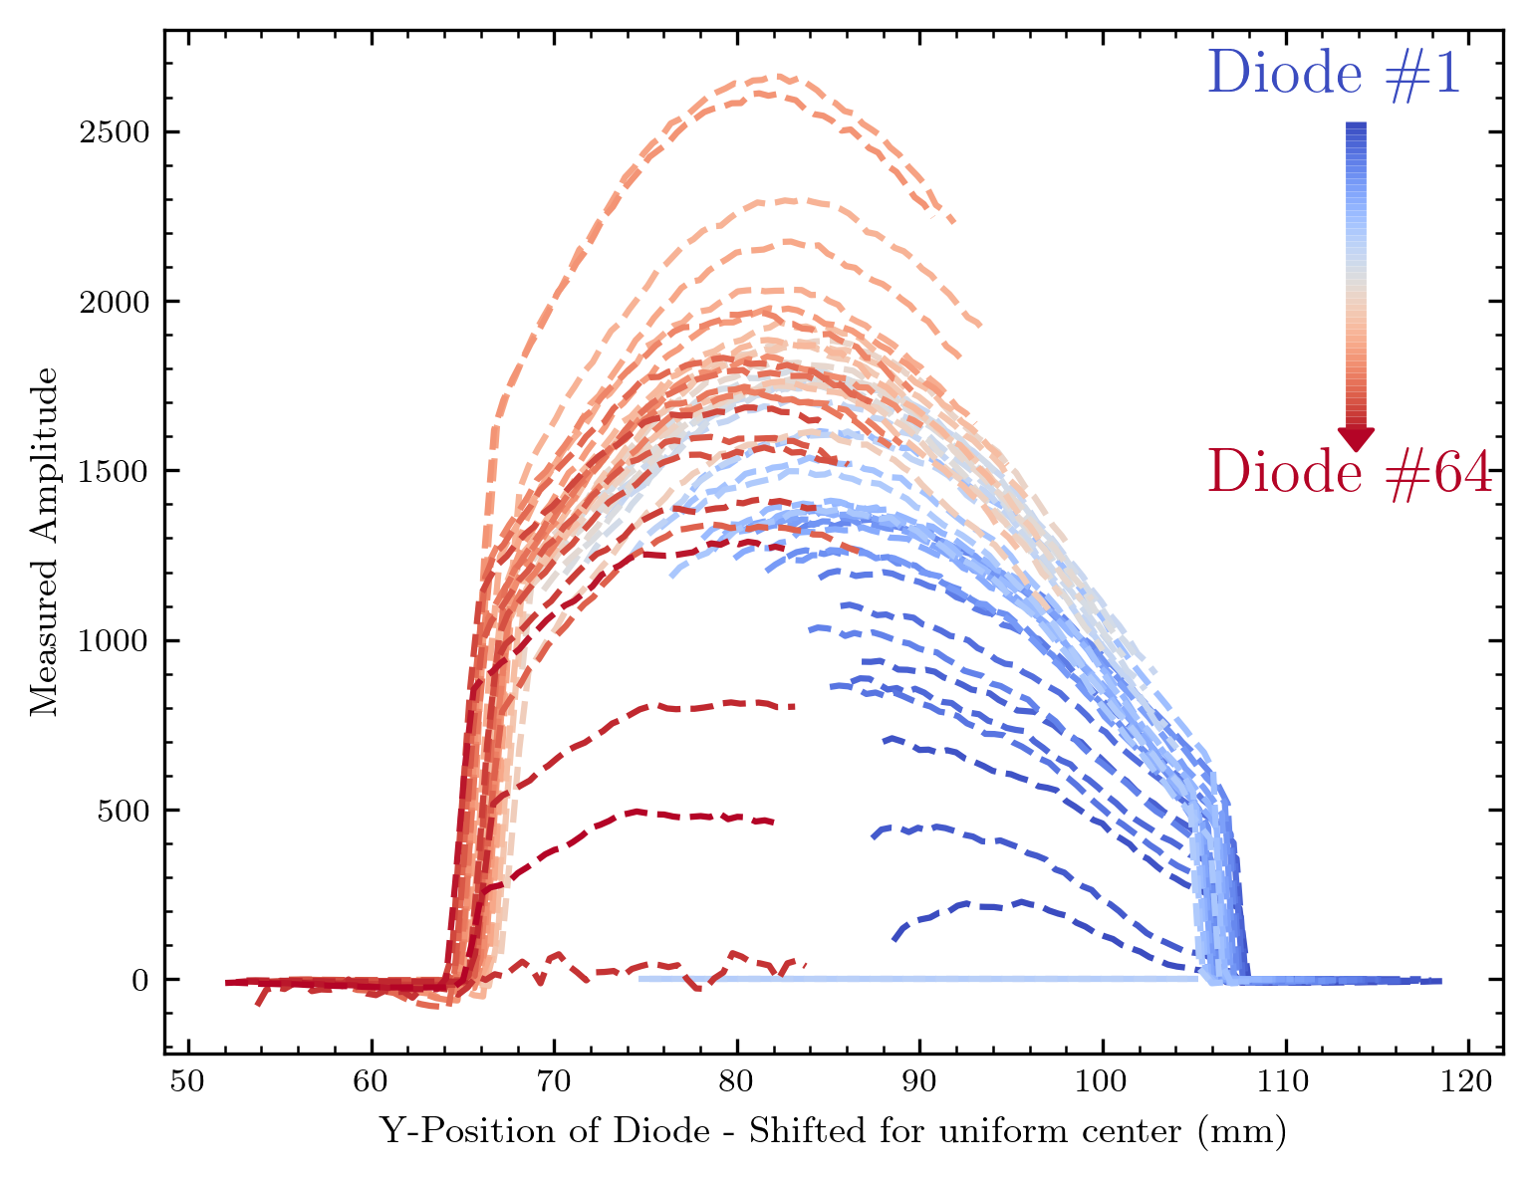
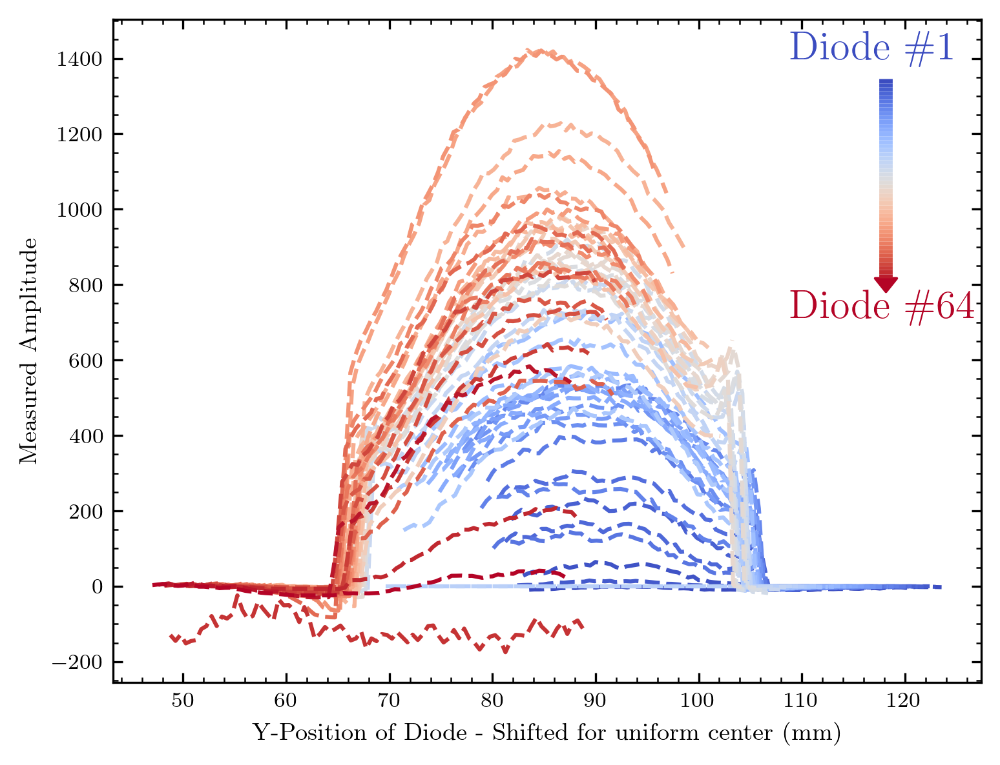
Signal vs. real y-position
Result:
The flattened beam behind the diffuser is not flat at all (shape comparable over the day)
The diodes show a differing response to the same signal -> Use this for normalizing

Slide 7
How to realize new normalization
Calculate the real position for each diode at each y-position
Mean the signal at each real position
To do this: Group positions in a certain range
For each diode: Calculate how the measured beam curve differs from the mean
I allow the following DOF : mean = signal diode * a
Realisation with different methods possible, currently I use a least_squares optimisation
More DOF are possible, then we‘re not only dependent from the channel, but also from the y-position (Assuming the linearity is - as measured before - nearly , there shouldn‘t be a big impact though)
Thus a factor is calculated for each channel

Slide 8
Some technical aspects
The factor is limited (to avoid artefacts in channels with no response during flat calibration): For the results shown to 0 and 3
The factor can be normalized, so that mean(factor) = 1 (Also done for results shown)
This calculation process is more complex (~ 5s), thus i built a quick storage as “normalization_factor.npy“ in the given data folder via np.save/np.load (< 0.001 s)
I always safe a raw factor without the 2 modifiactions above, to allow later modifications of these after loading
This process is rather complex, but I could not think of a more direct way ... So maybe you have some ideas/questions

Slide 9
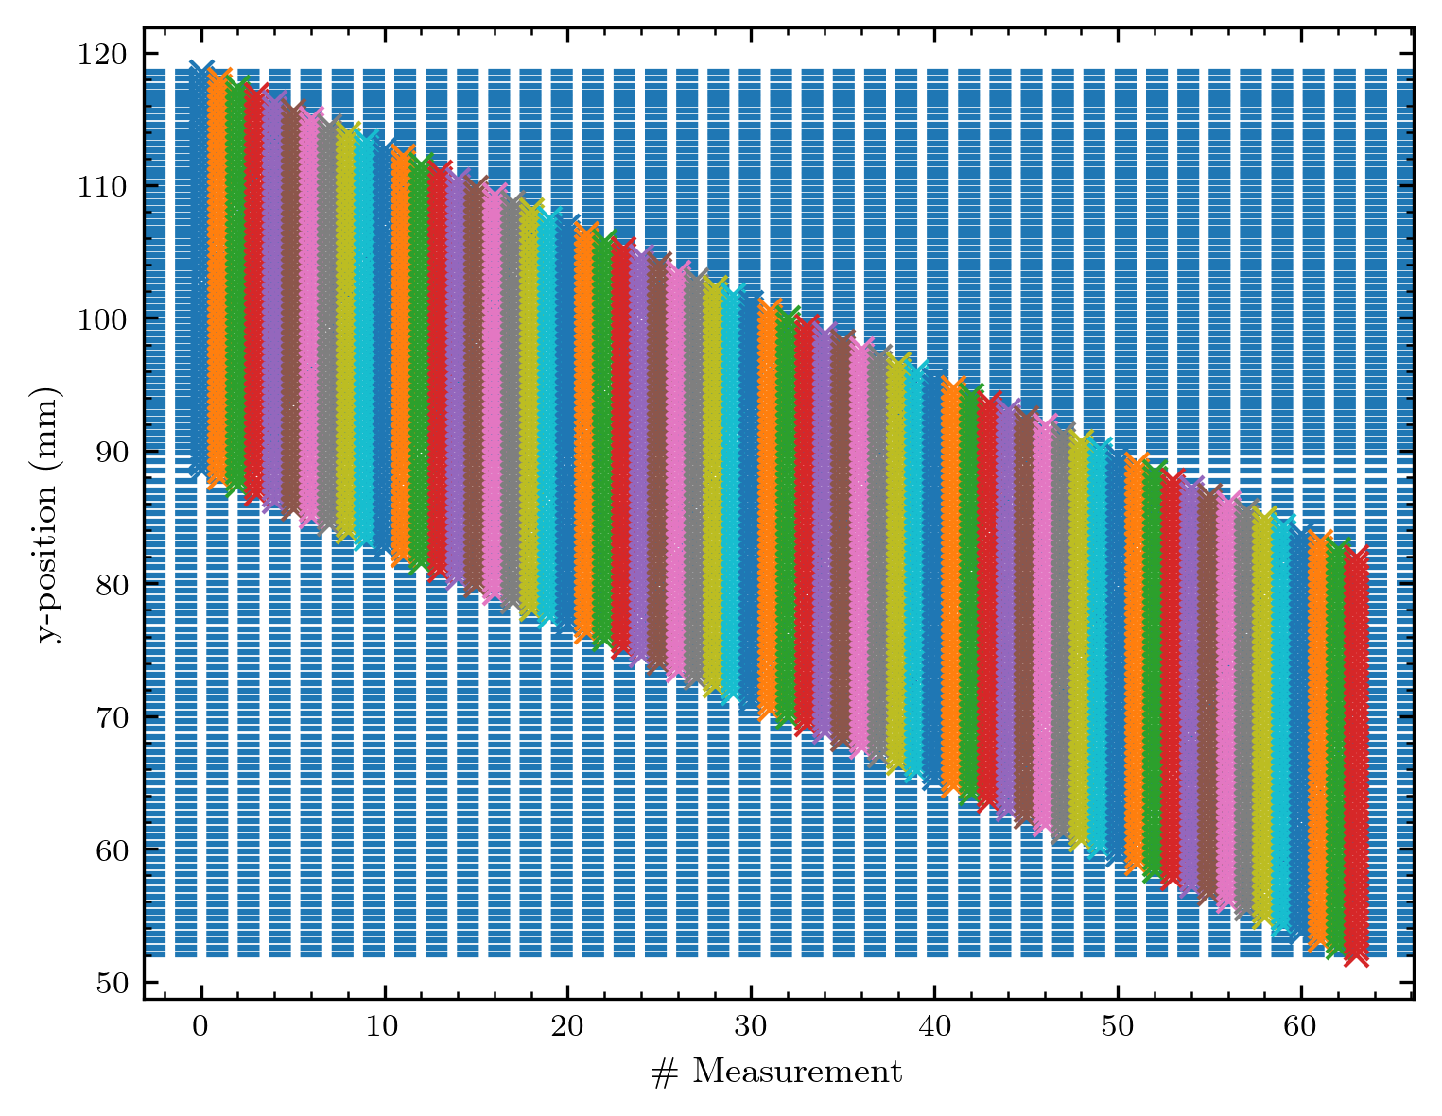
The real positions
Here a visualisation how the real y-positions are calculated and grouped (I use the distance of 1xdiode size to group)
The signal increase is a bit smeared out (compare next slide), so there could be some offset in the diode array? (how accurate is the fabrication process) or some inaccuracy in moving the array (e.g. if the array is mounted slightly tilted)
Future Improvement for this: Detect the signal increase/decrease and rather use this for sorting

Slide 10
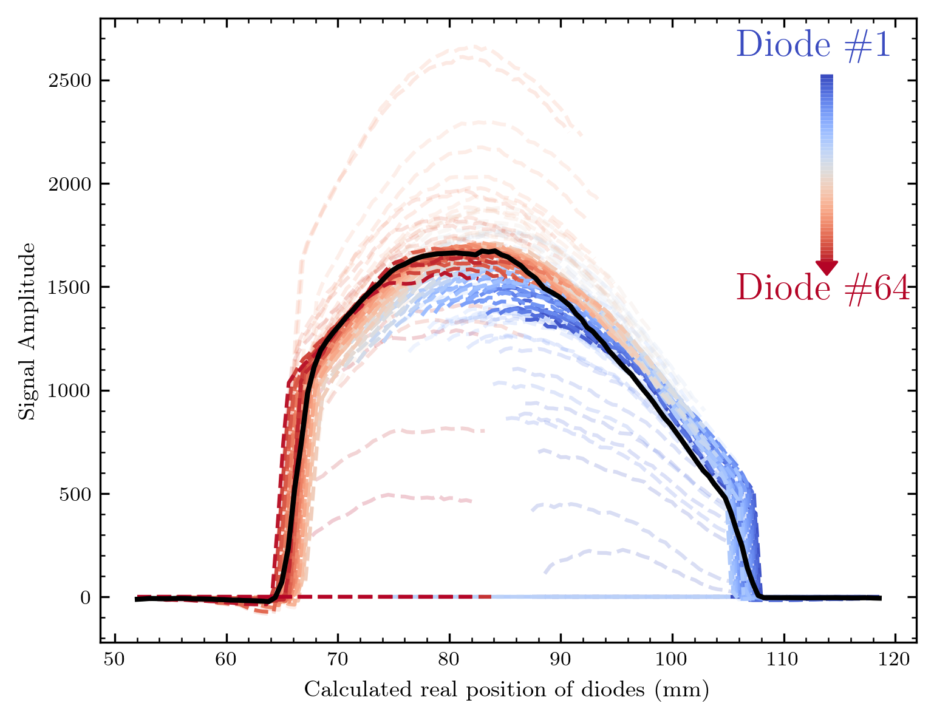
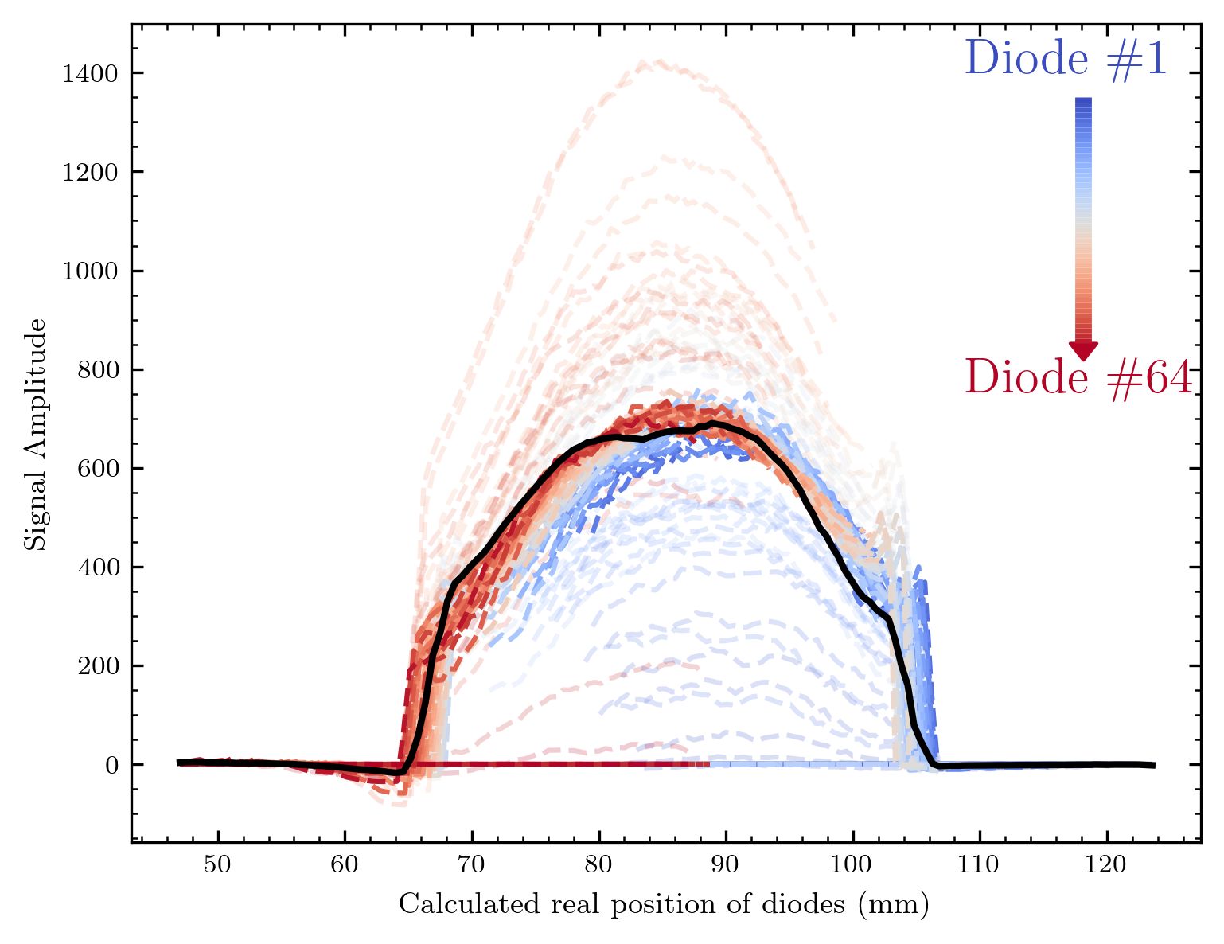
The new normalization factor
In black the calculated mean, As visible I‘m able to get the diode signals far more homogenous

Slide 11
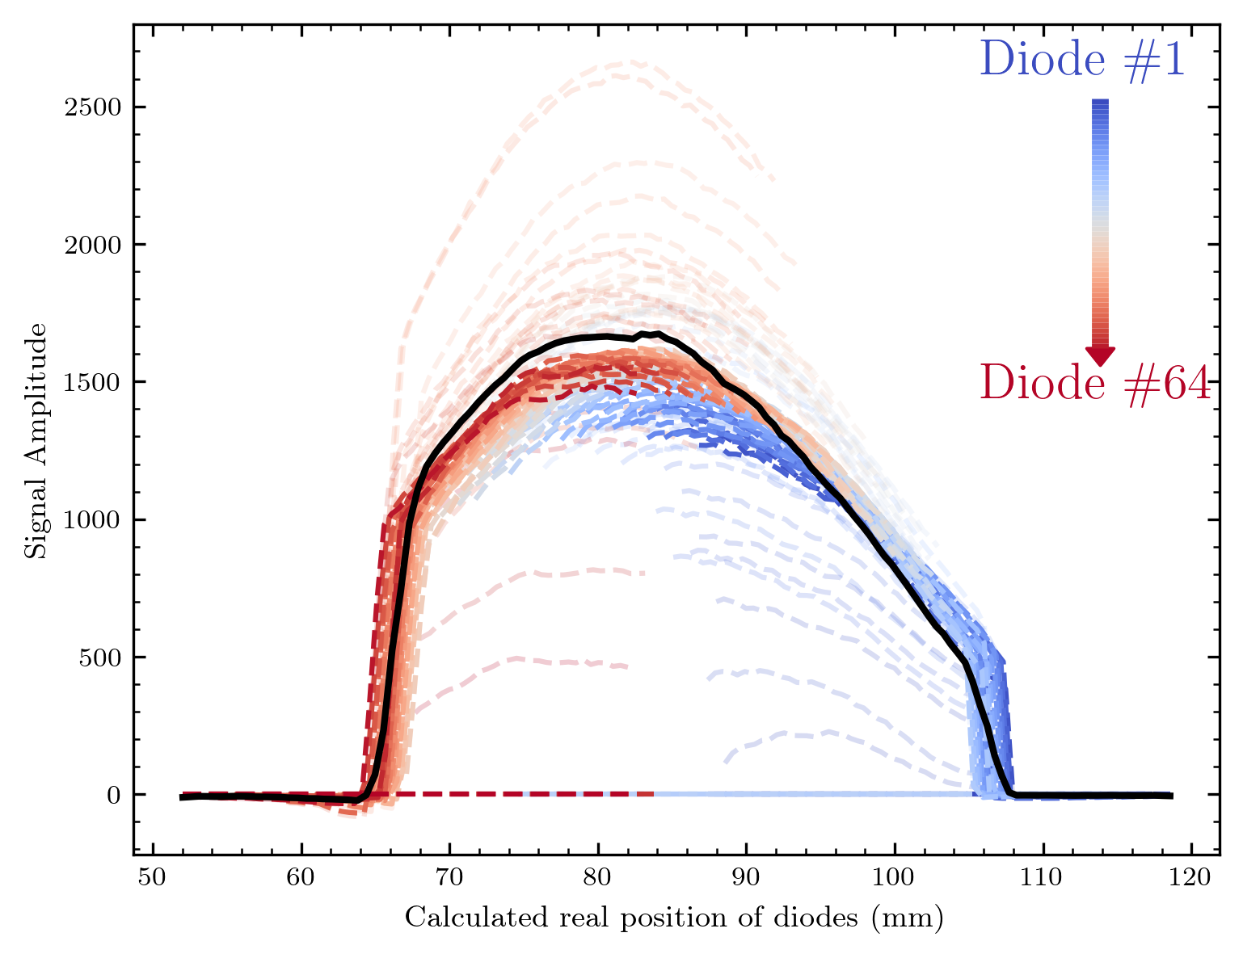
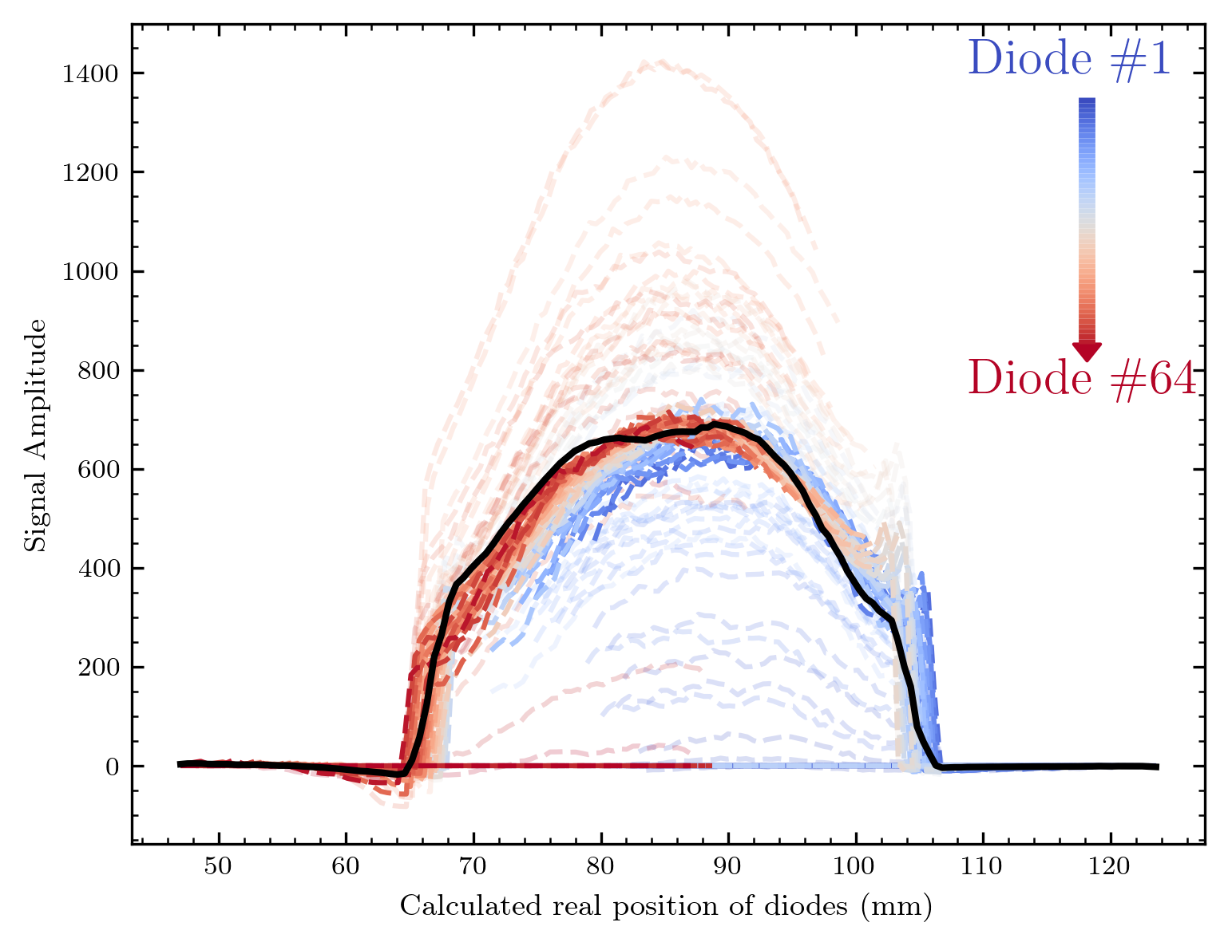
Normalization with normalized factor
With mean(factor) = 1 we of course get an offset from the mean here

Slide 12
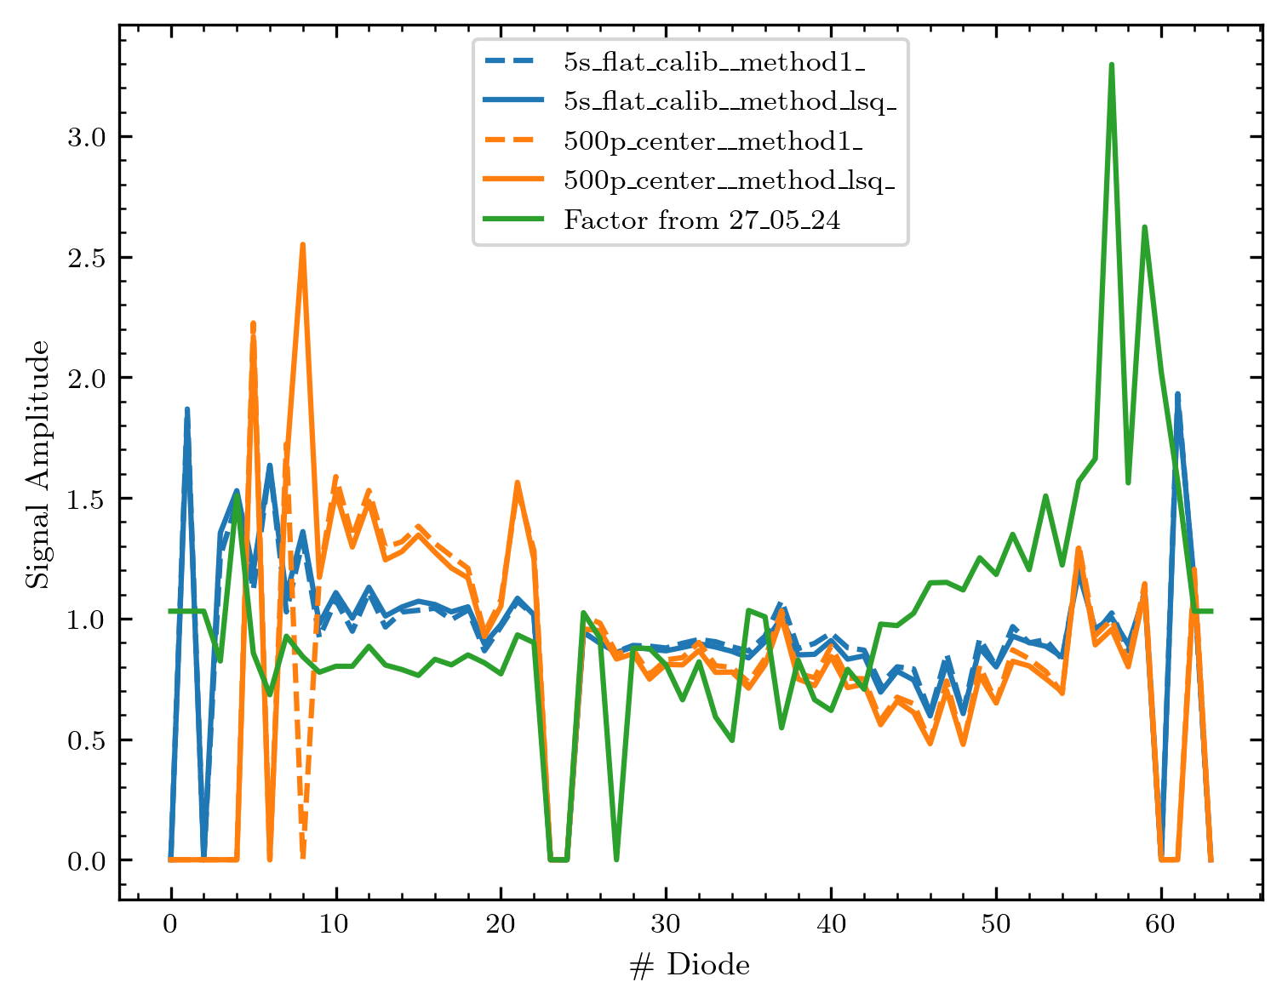
Factor comparison
Comparison of the factors for 2 methods(lsq = least_squares, method 1 = mean of deviation at each position compared to mean)
Also the factor from the first Cyrcè measurements is shown in green
The methods give nearly the same result
The behaviour between the two measurements at the 19.06. is differing, but especially for the diodes with #30+ not too much different

Slide 13
One addition that might be important?!
Correct for the beam shape in y-direction (but this assumes that it remains comparable over the day)
Possible if assigning the measured real position here to the y-positions in the maps measured

Slide 14
The maps
I will show the maps with / without normalization in the following with a short picture context to each measurement
Measurements are shown in realistic pixels and interpolated contourf version (as before)
If multiple y position were measured, I‘ll show 2 maps
Combining two will be one of the next steps

Slide 15
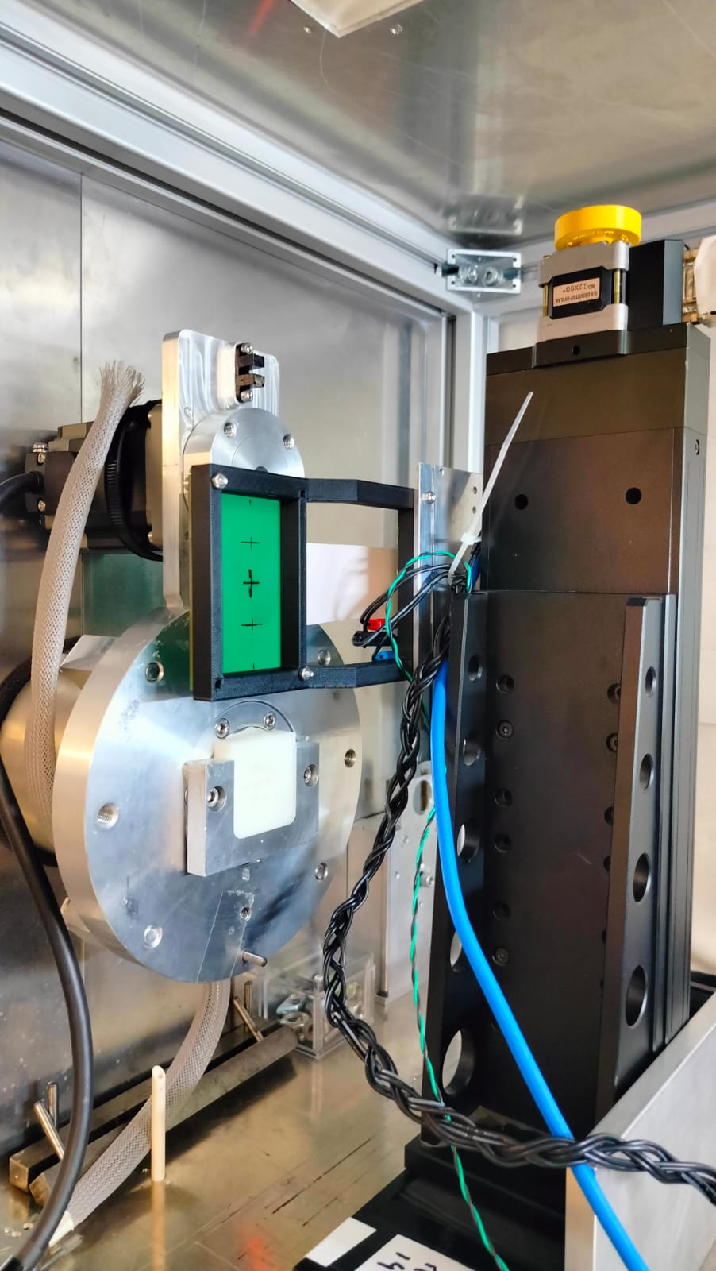
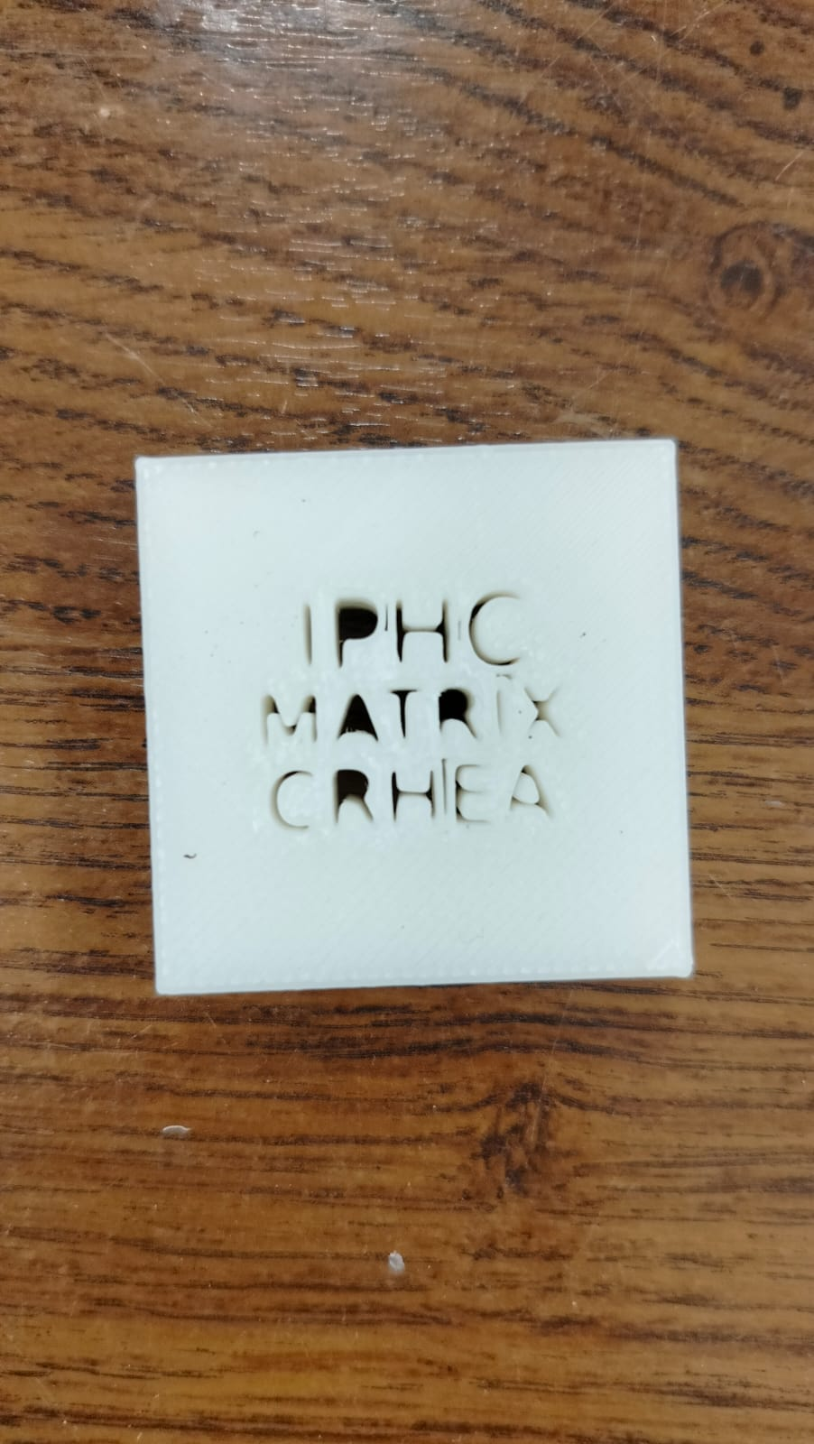
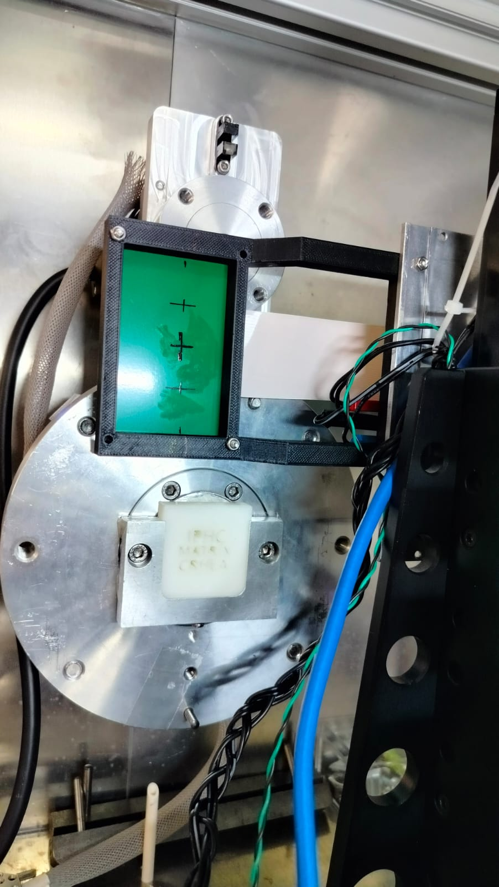
IPHC Matrix CRHEA logo

Slide 16
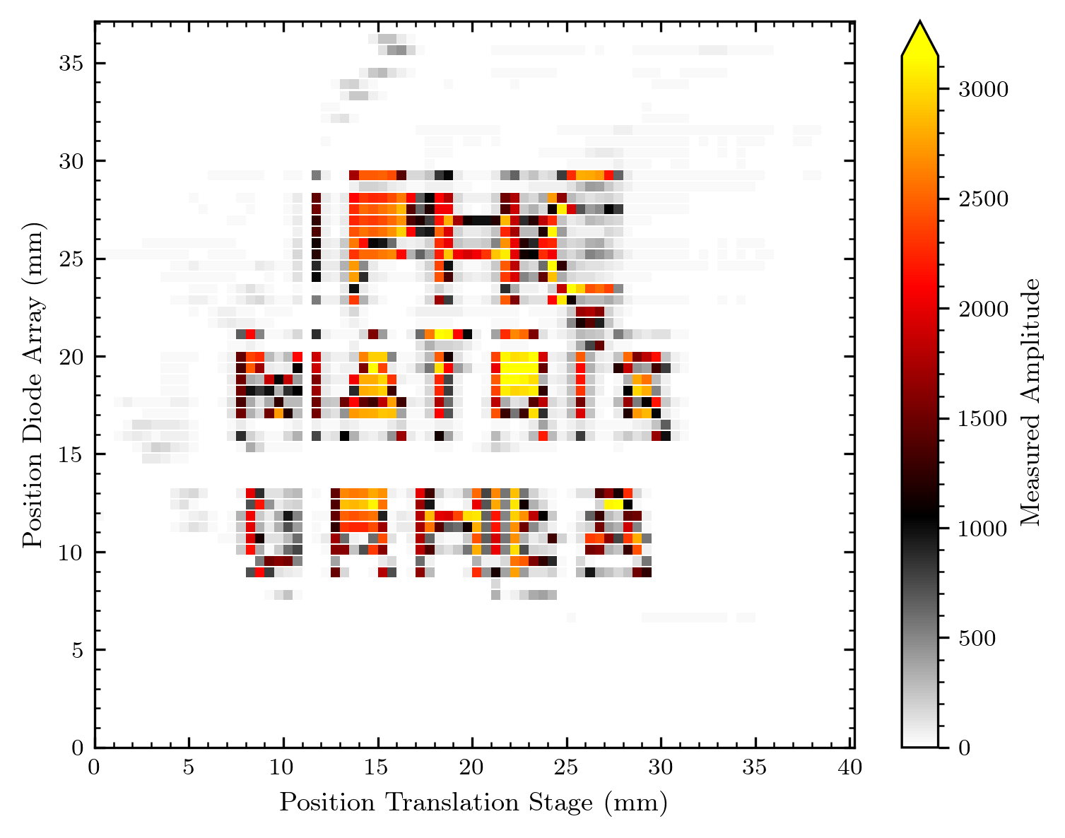
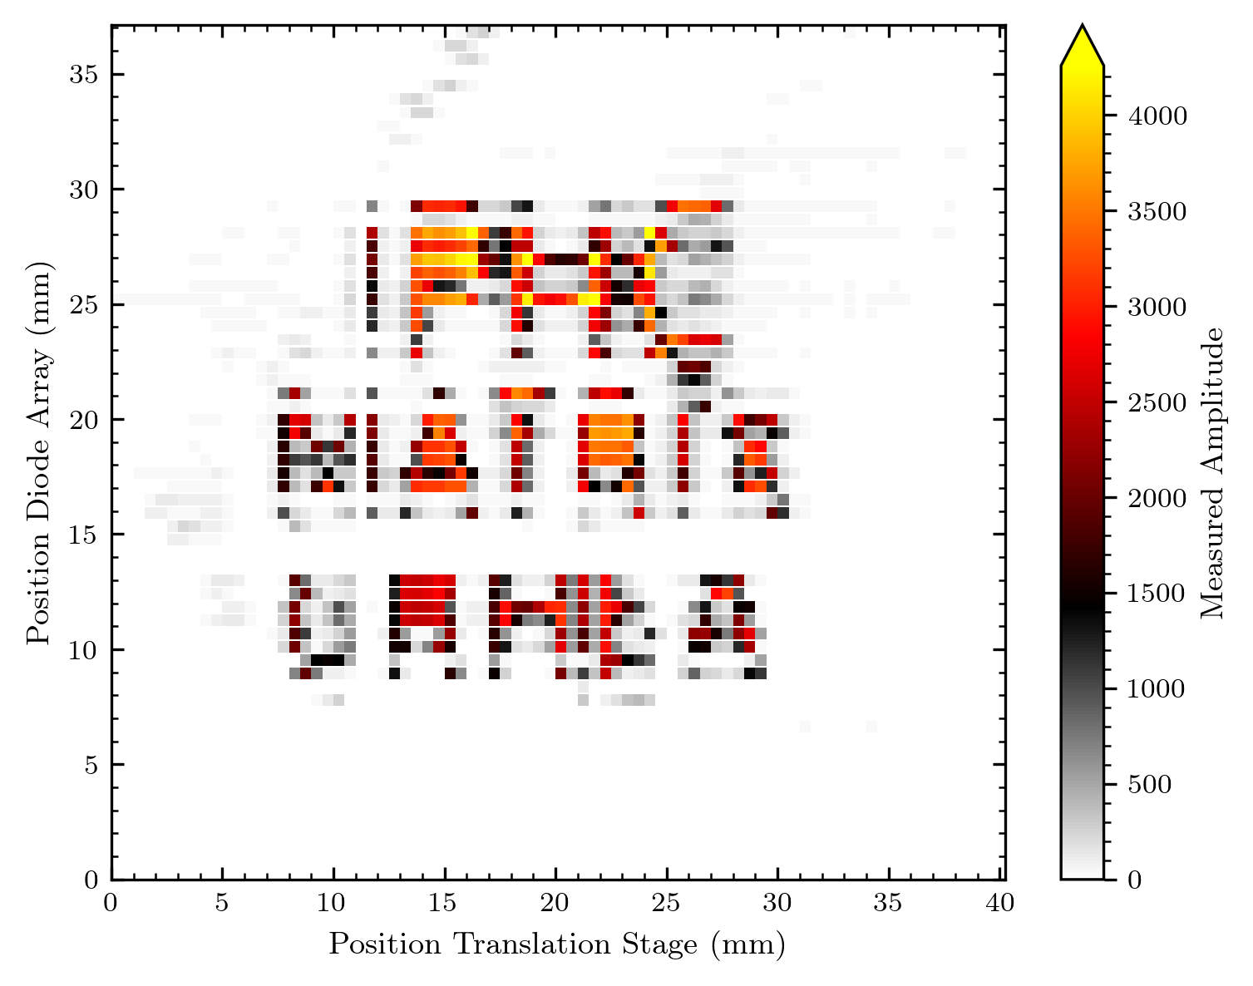
IPHC Matrix CRHEA logo
Normalized
Not normalized

Slide 17
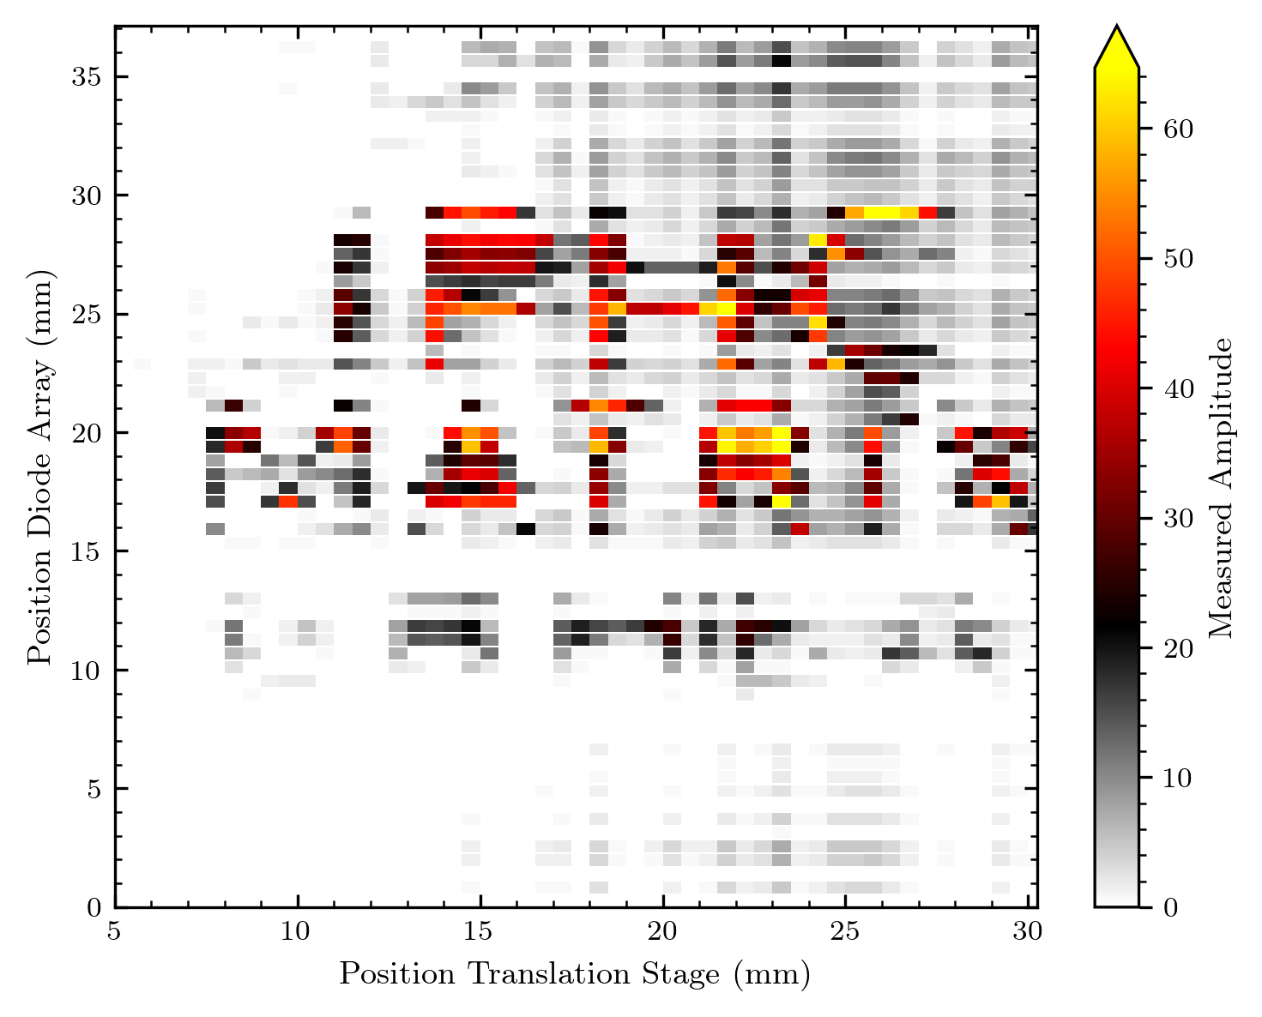
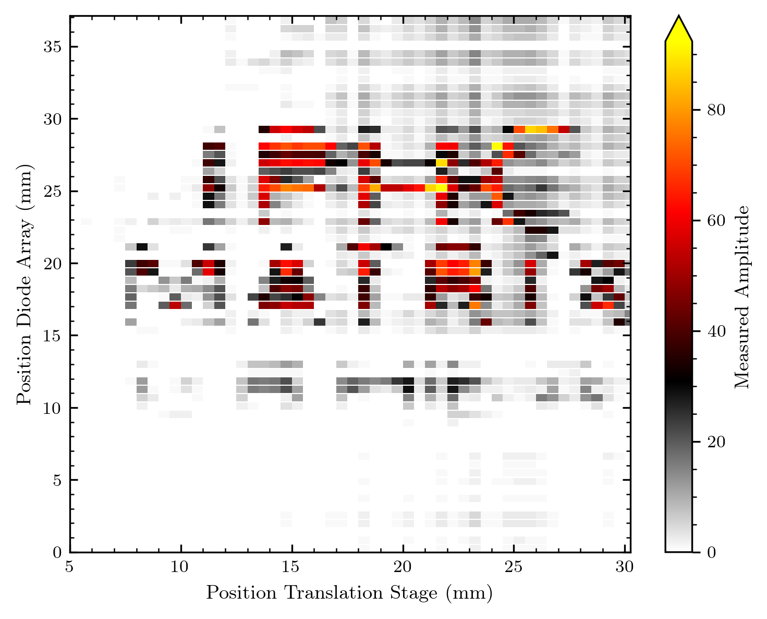
IPHC Matrix CRHEA logo 2 (“neonoff“)
Normalized

Slide 18
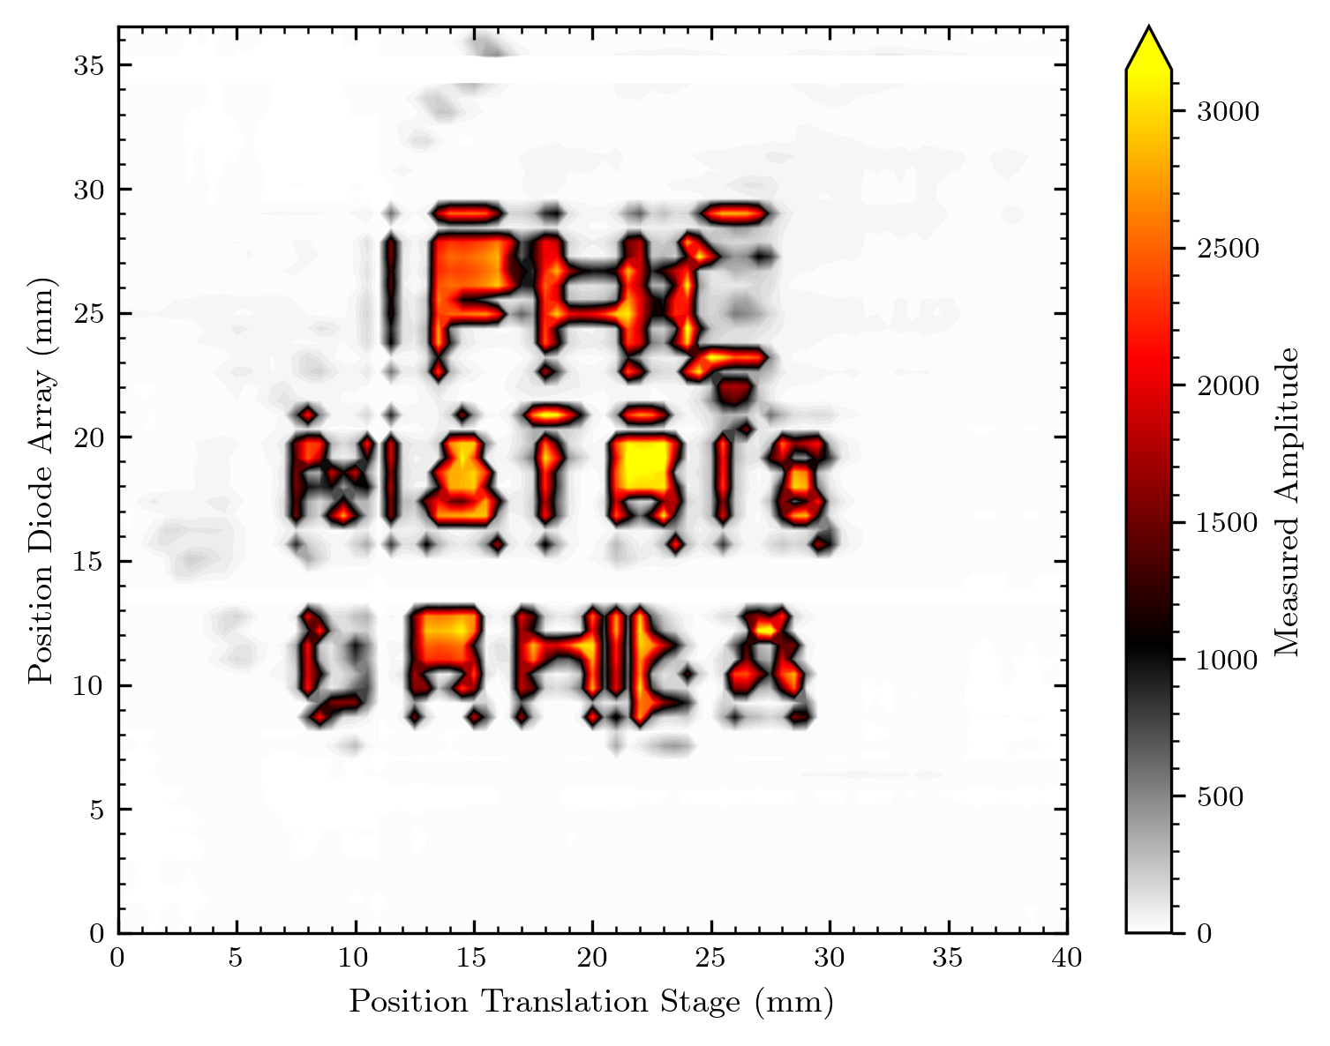
IPHC Matrix CRHEA logo

Slide 19
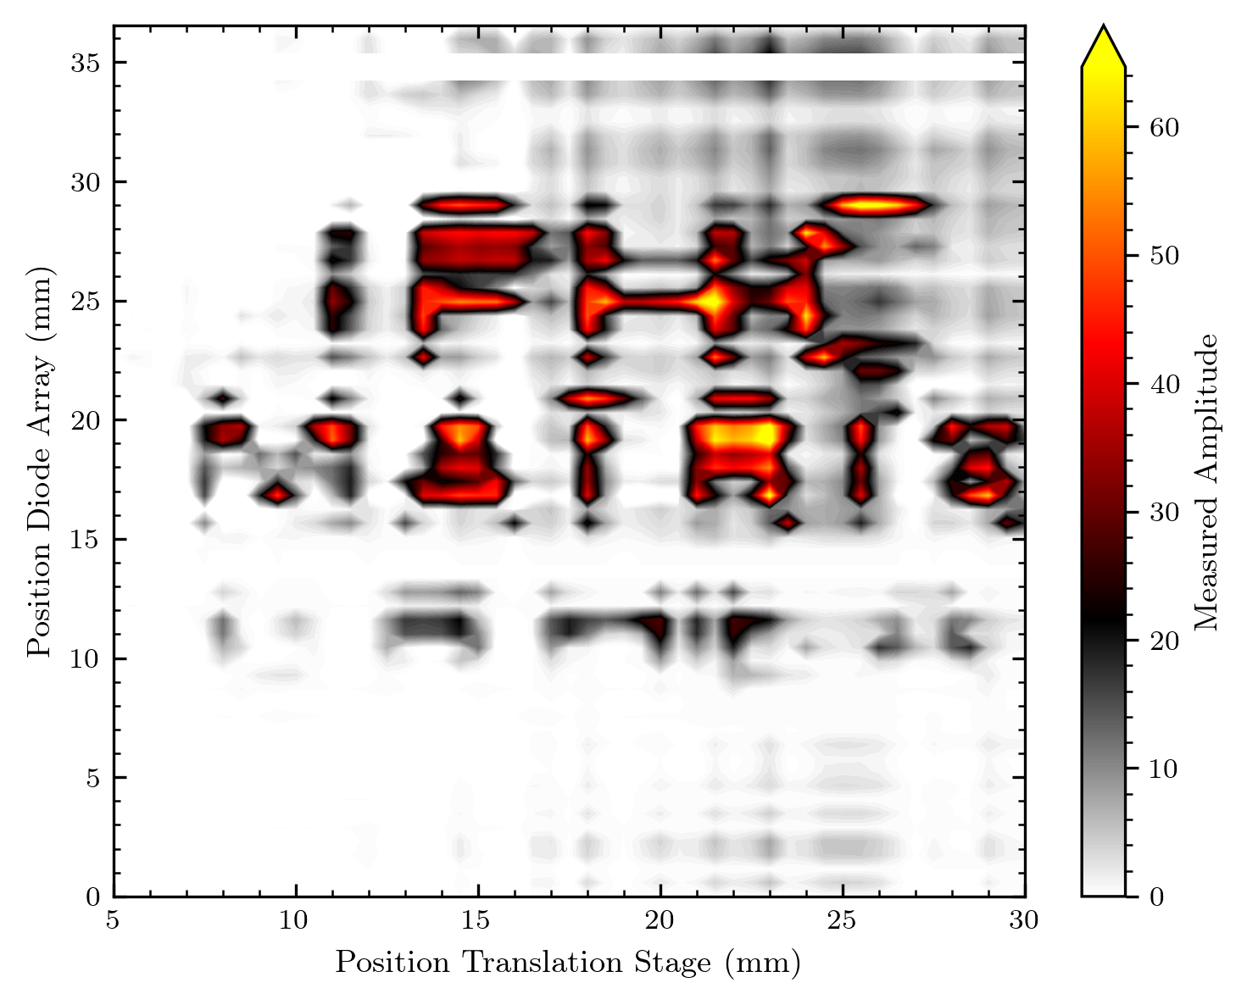
IPHC Matrix CRHEA logo 2 (“neonoff“)

Slide 20
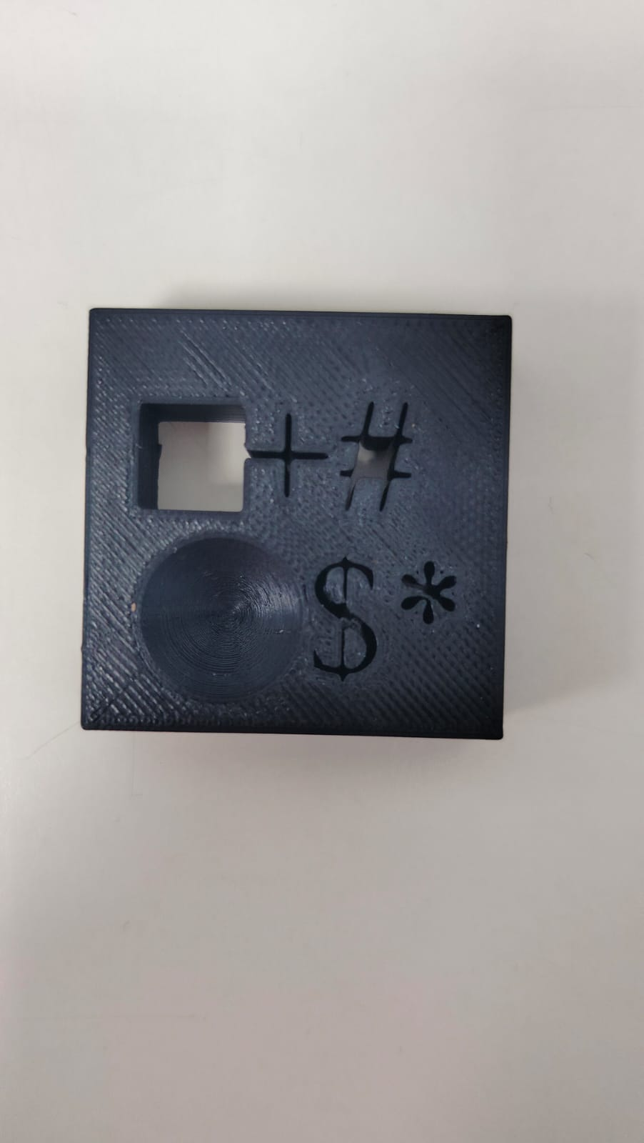
Mixed symbols mask

Slide 21
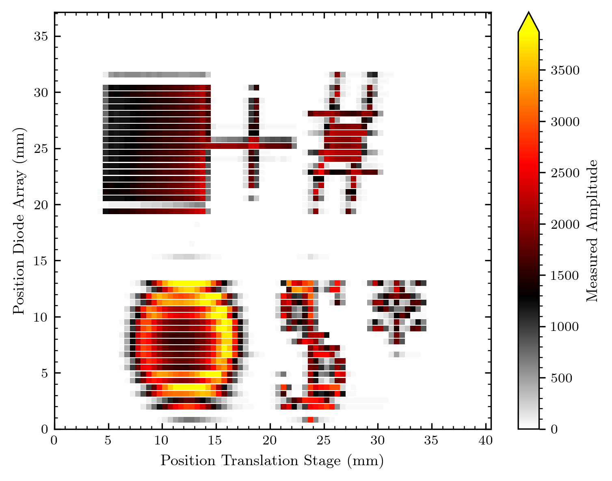
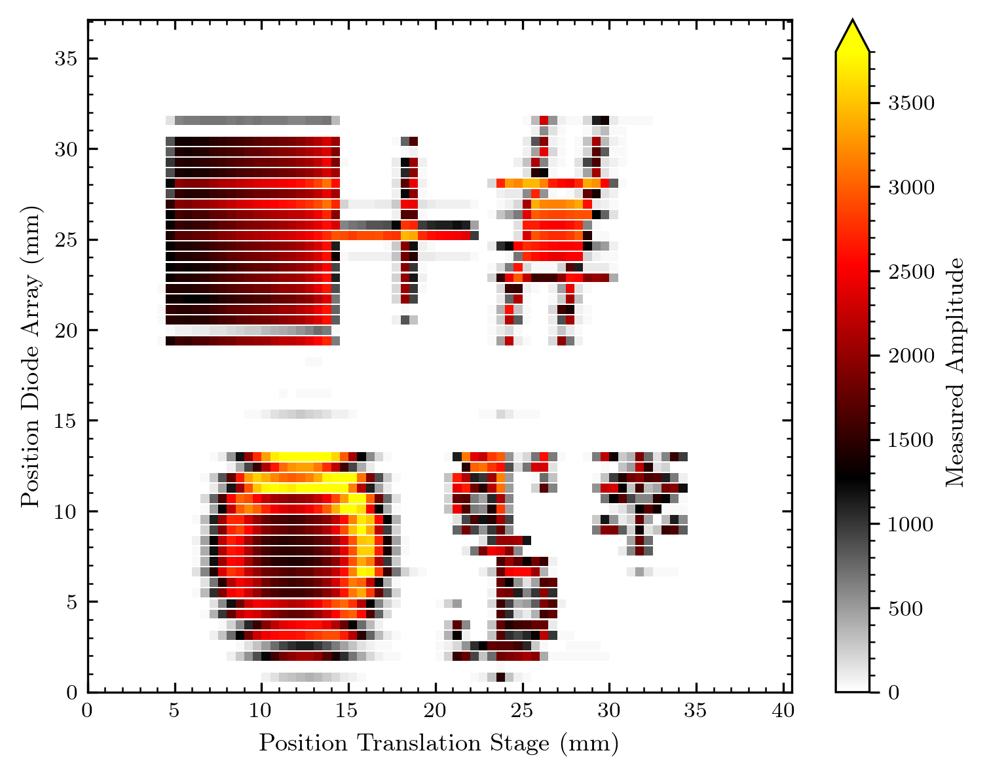
Mixed symbols mask
Here the normalization seems to be an improvement

Slide 22
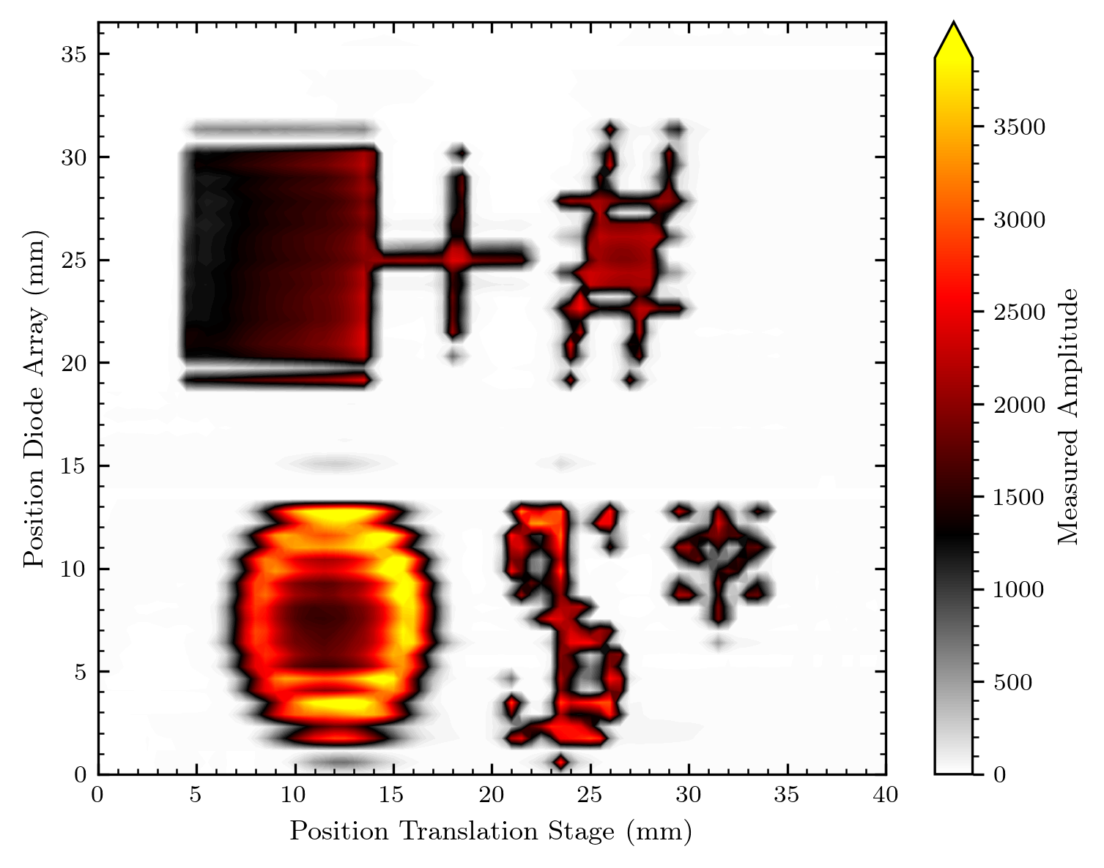
Mixed symbols mask
Here the Bragg-peak effect is well visible I‘d say

Slide 23
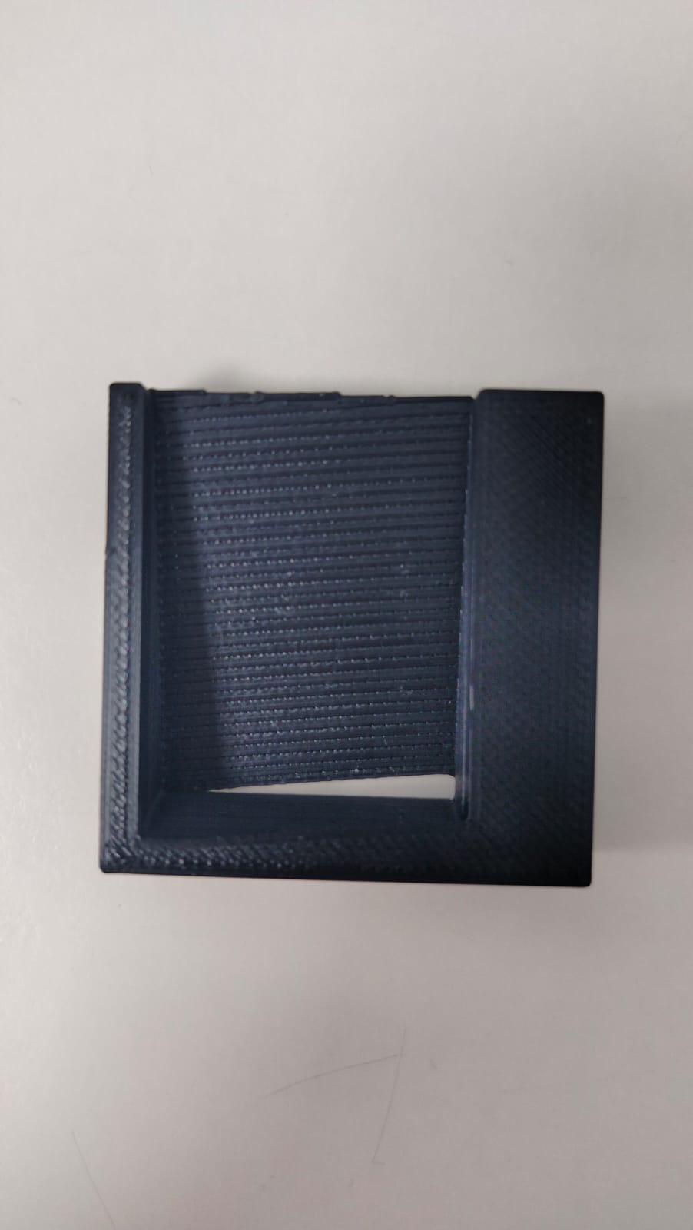
Biseau 2D-big black trapeze

Slide 24
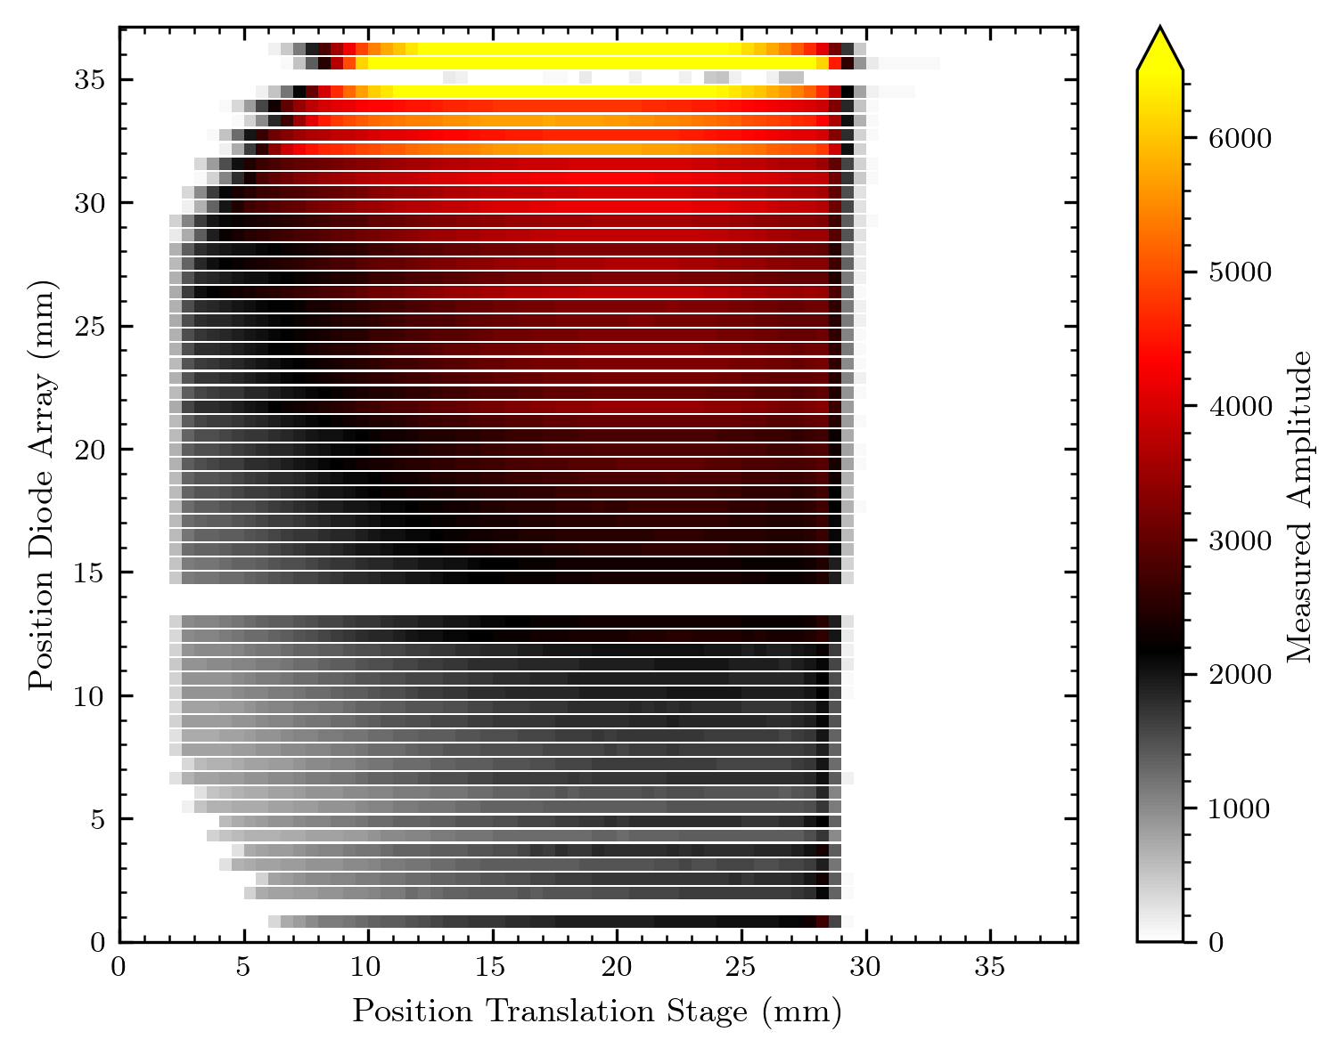
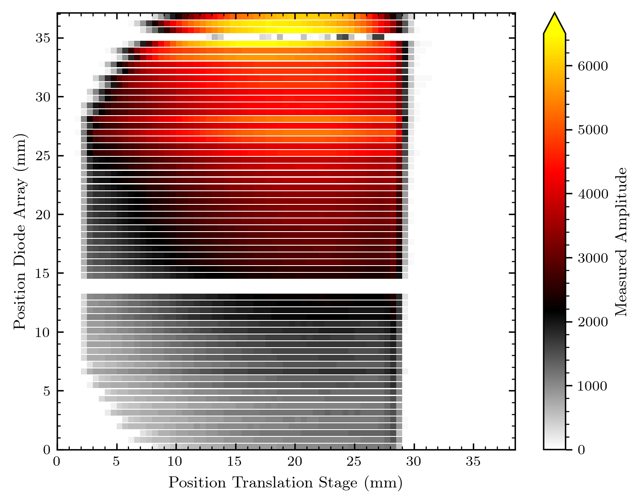
Biseau 2D-big black trapeze

Slide 25
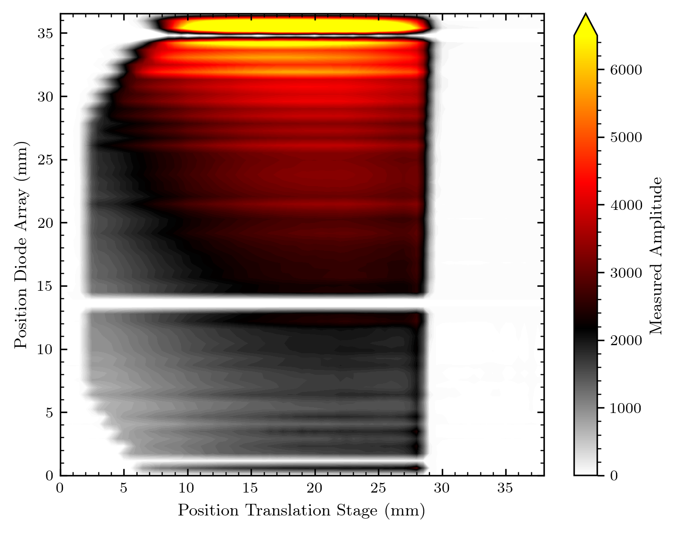
Biseau 2D-big black trapeze

Slide 26
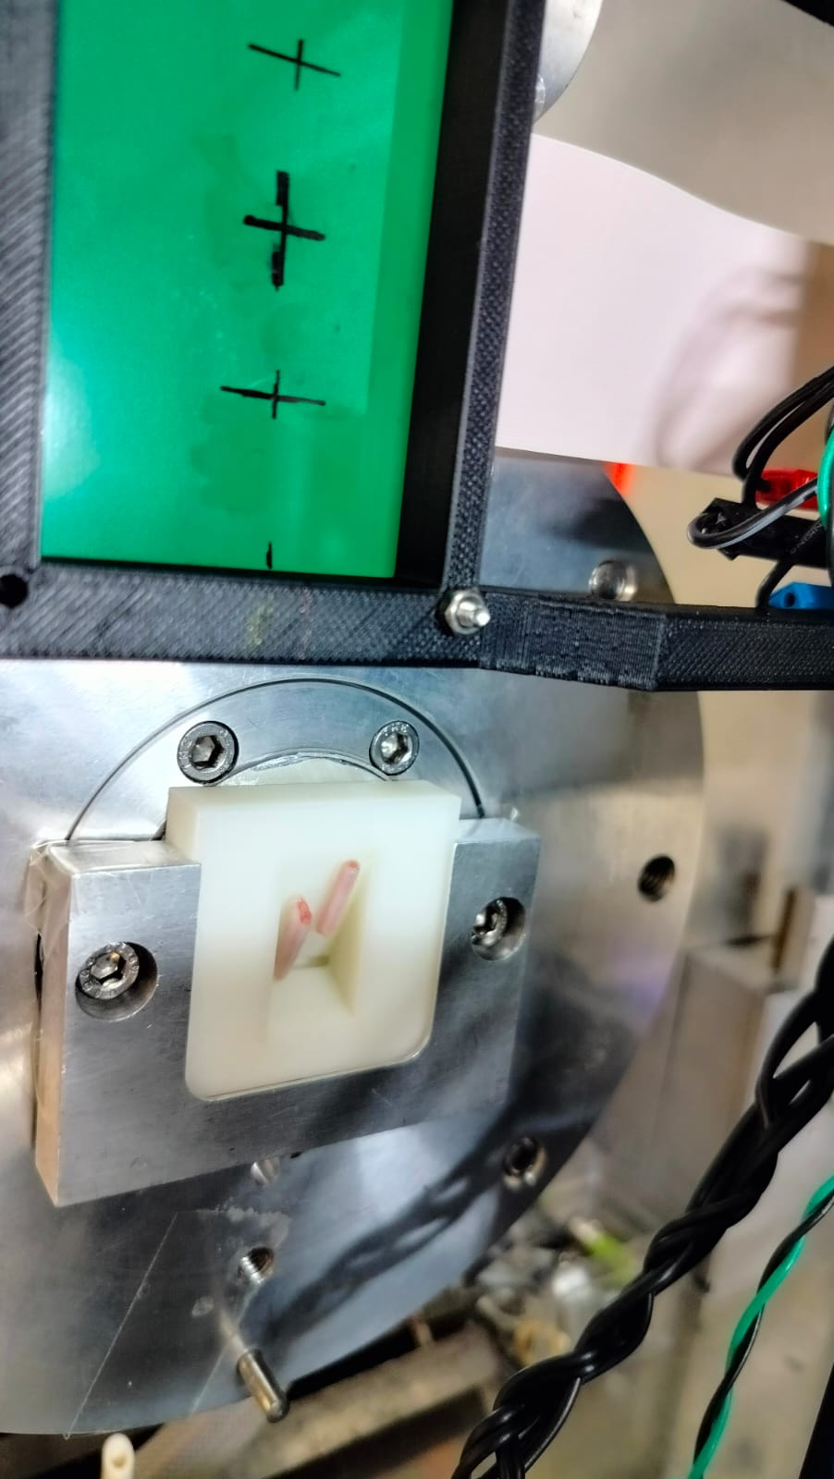
white trapeze – biseau blanc
picture only with rat tails

Slide 27
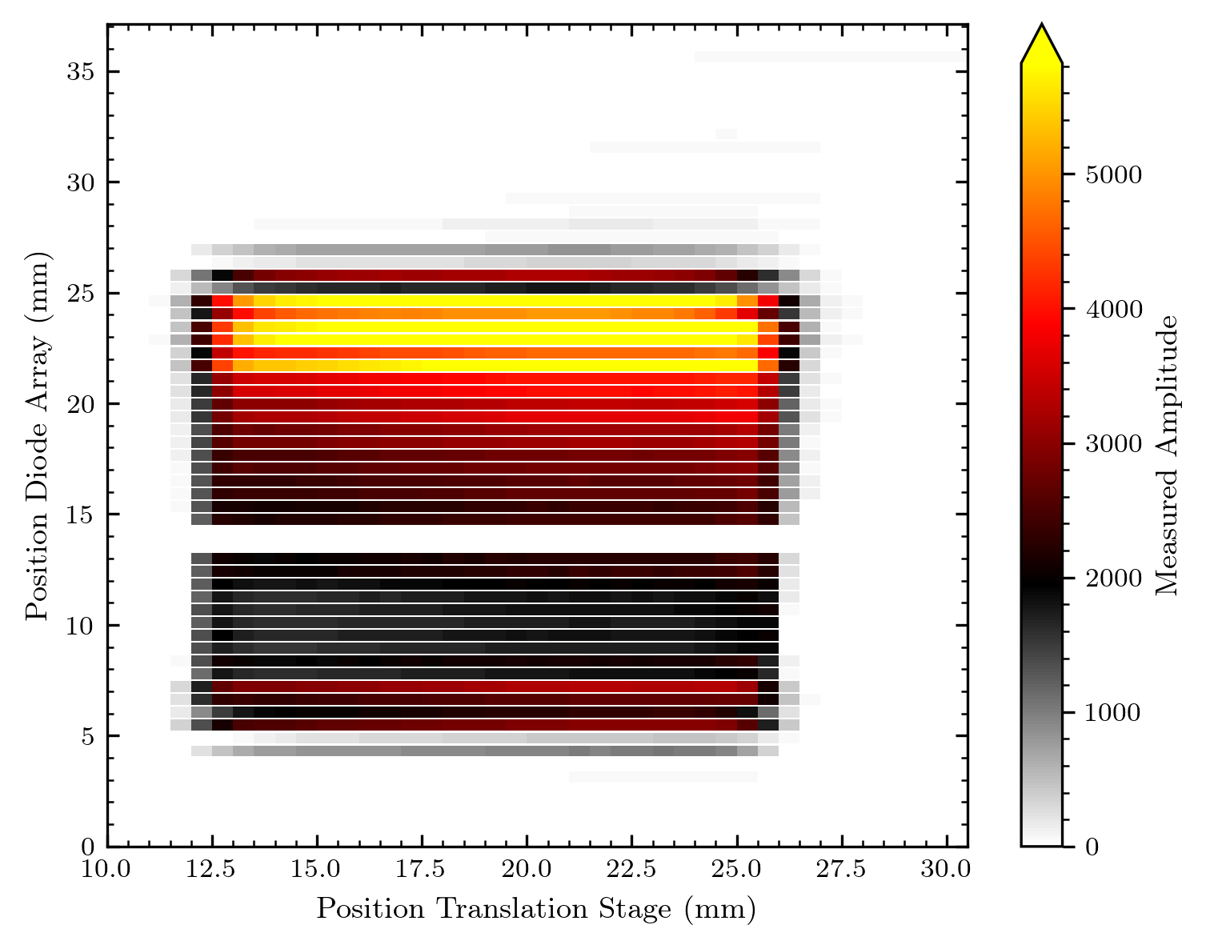
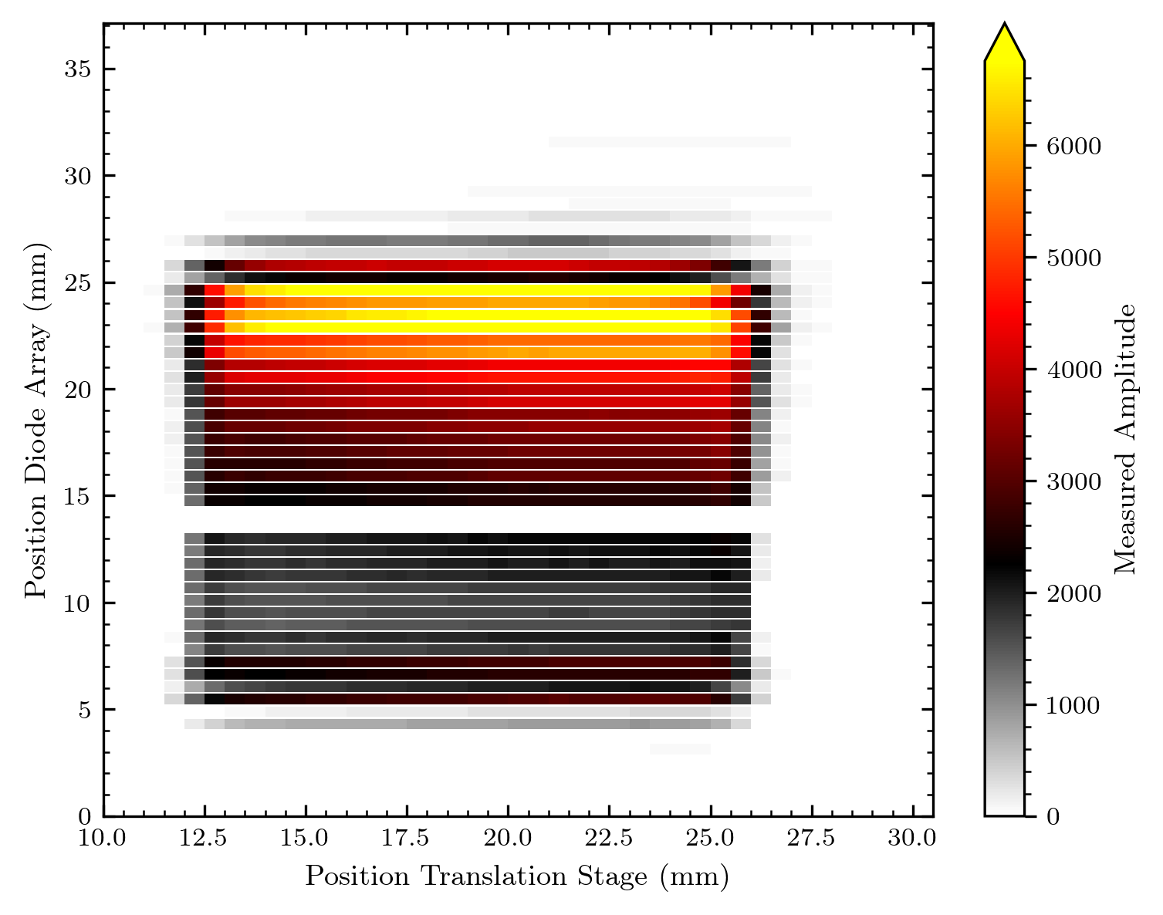
white trapeze – biseau blanc

Slide 28
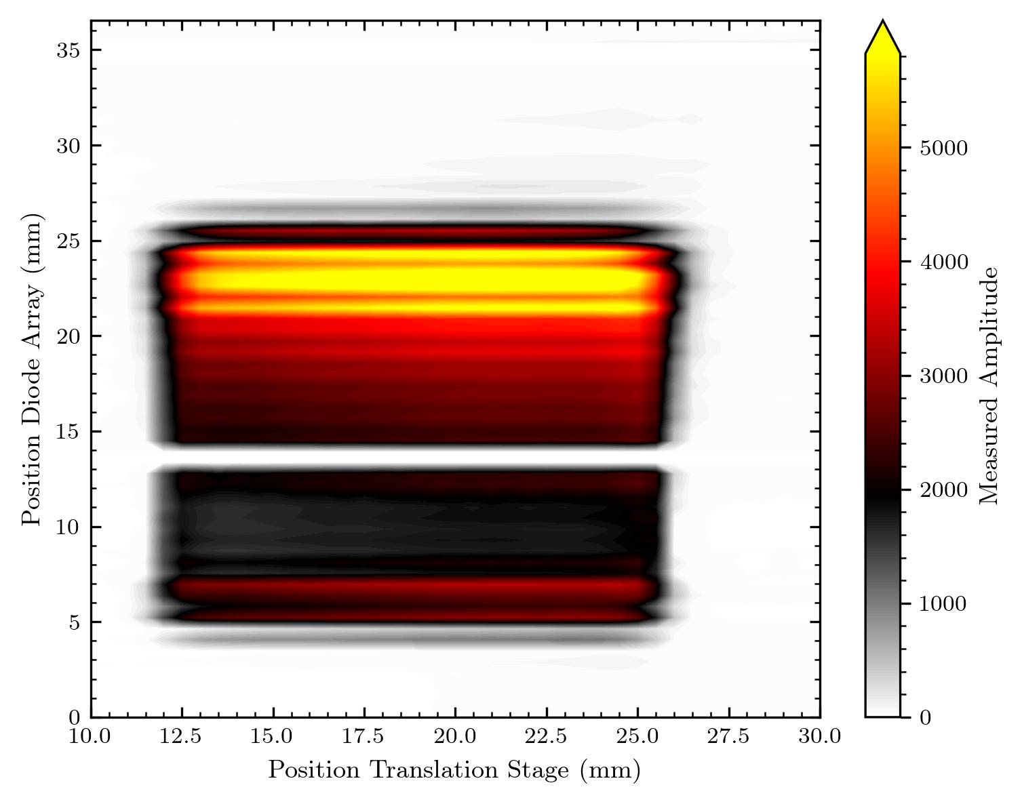
white trapeze – biseau blanc
picture only with rat tails

Slide 29
From now just normalized maps, left/right for height or picture comparison

Slide 30
Rat tails on the white trapeze – biseau blanc

Slide 31
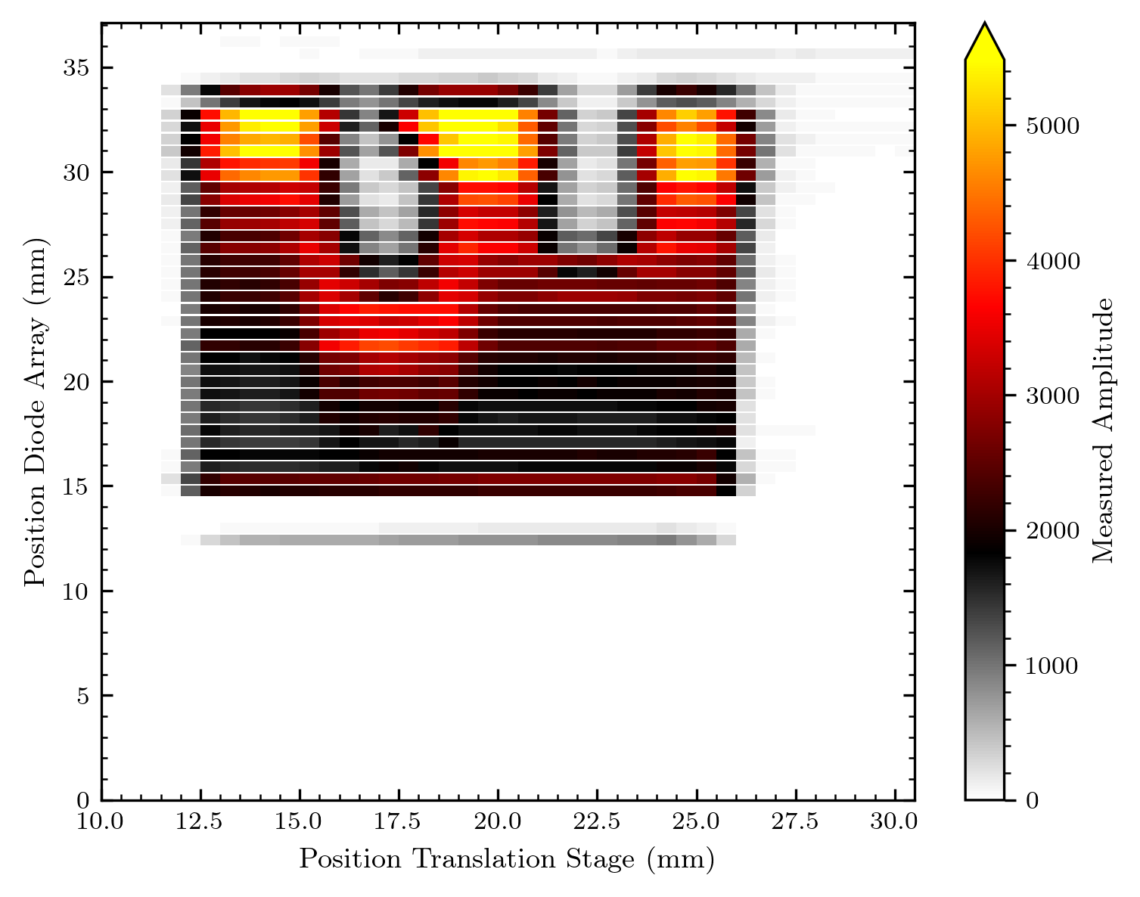
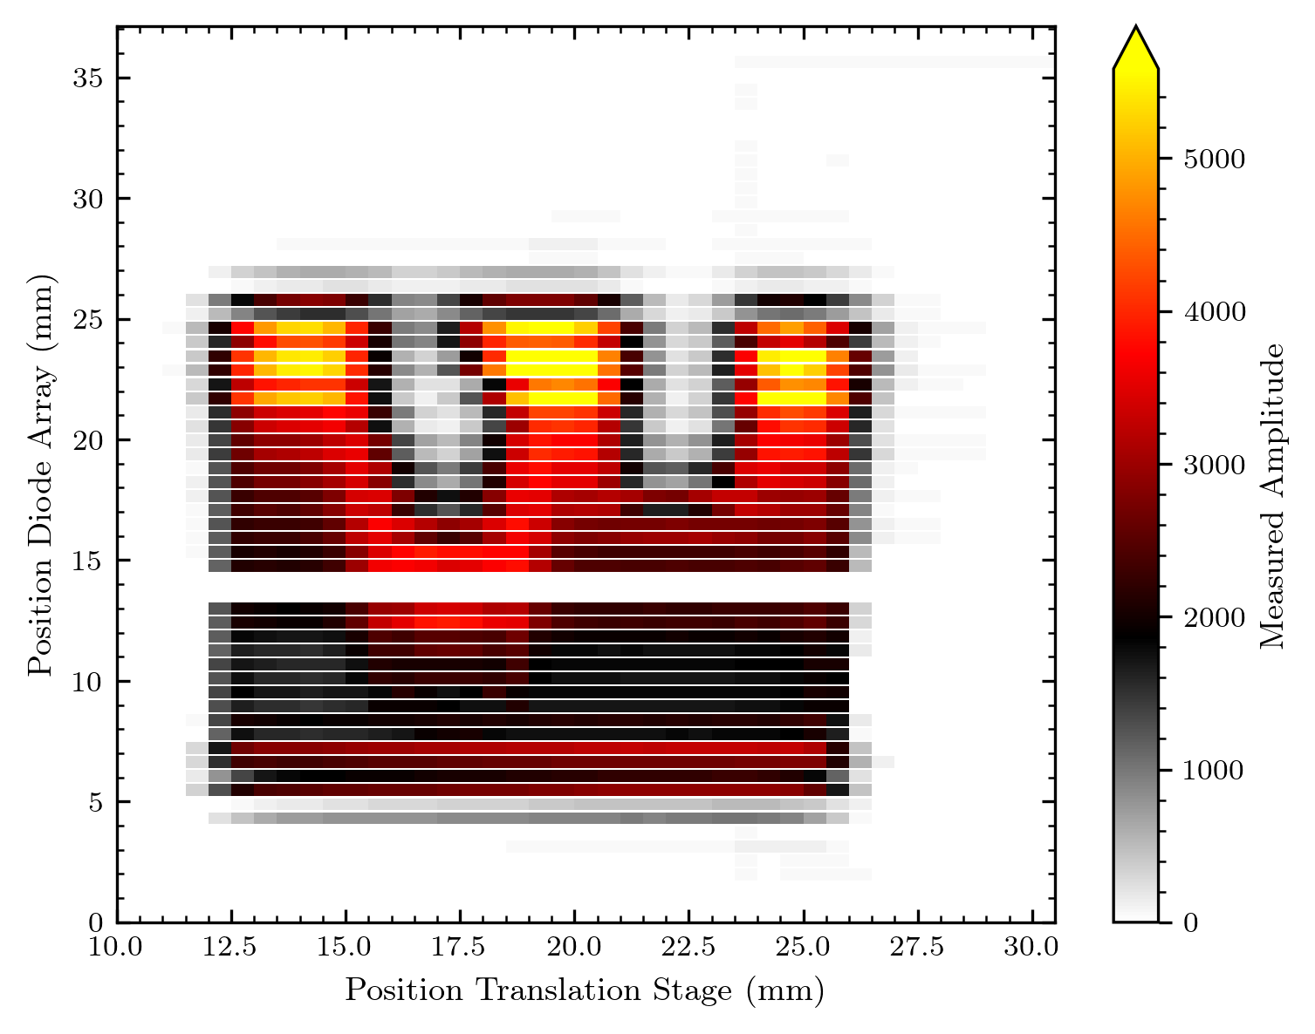
Rat tails on the white trapeze – biseau blanc

Slide 32


Rat tails on the white trapeze – biseau blanc

Slide 33
Rat tails on the white trapeze – biseau blanc

Slide 34
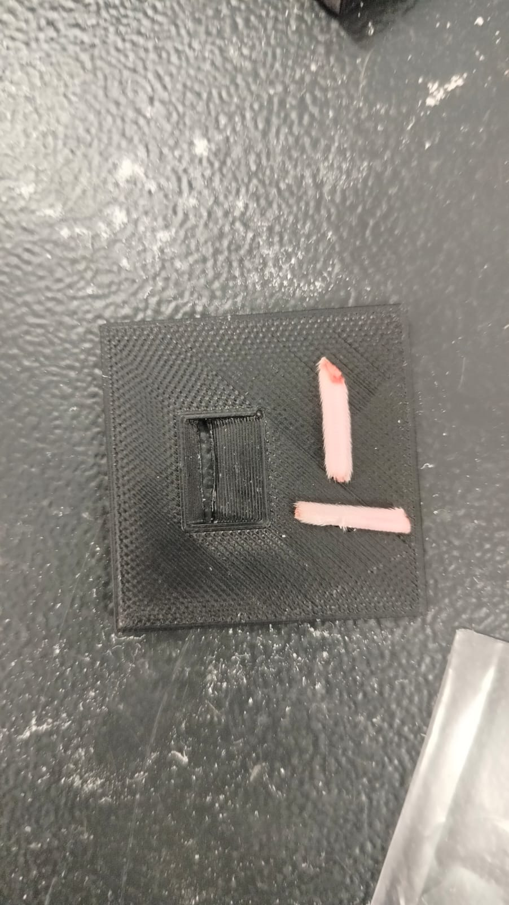
Rat tails on flat surface

Slide 35
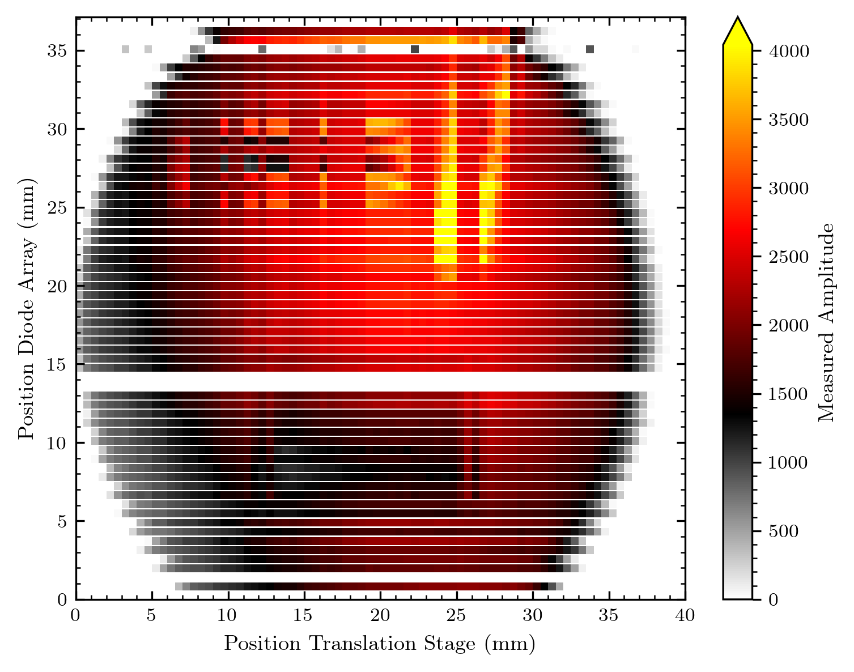
Rat tails on flat surface

Slide 36
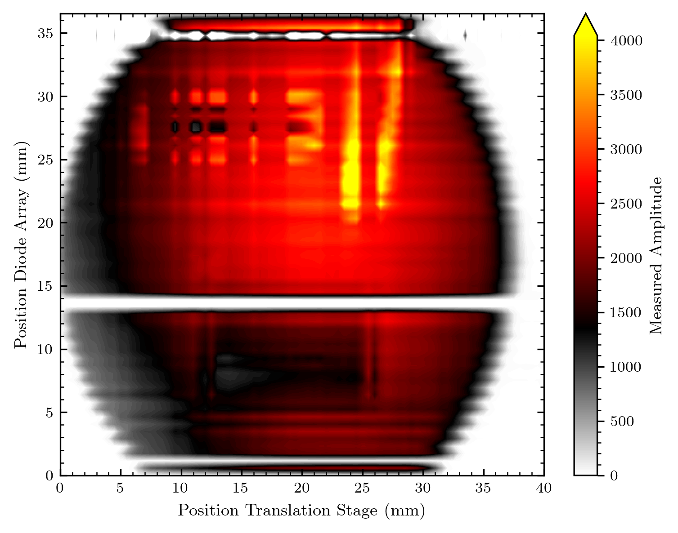
Rat tails on flat surface

Slide 37
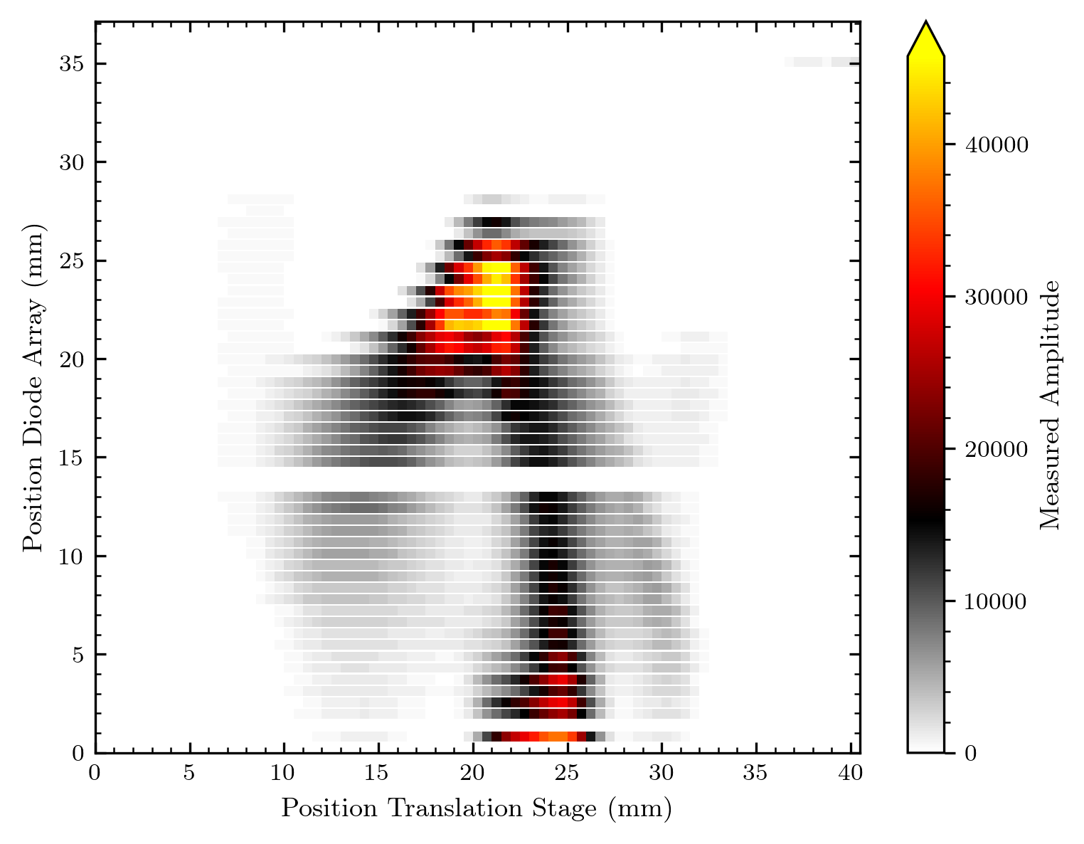
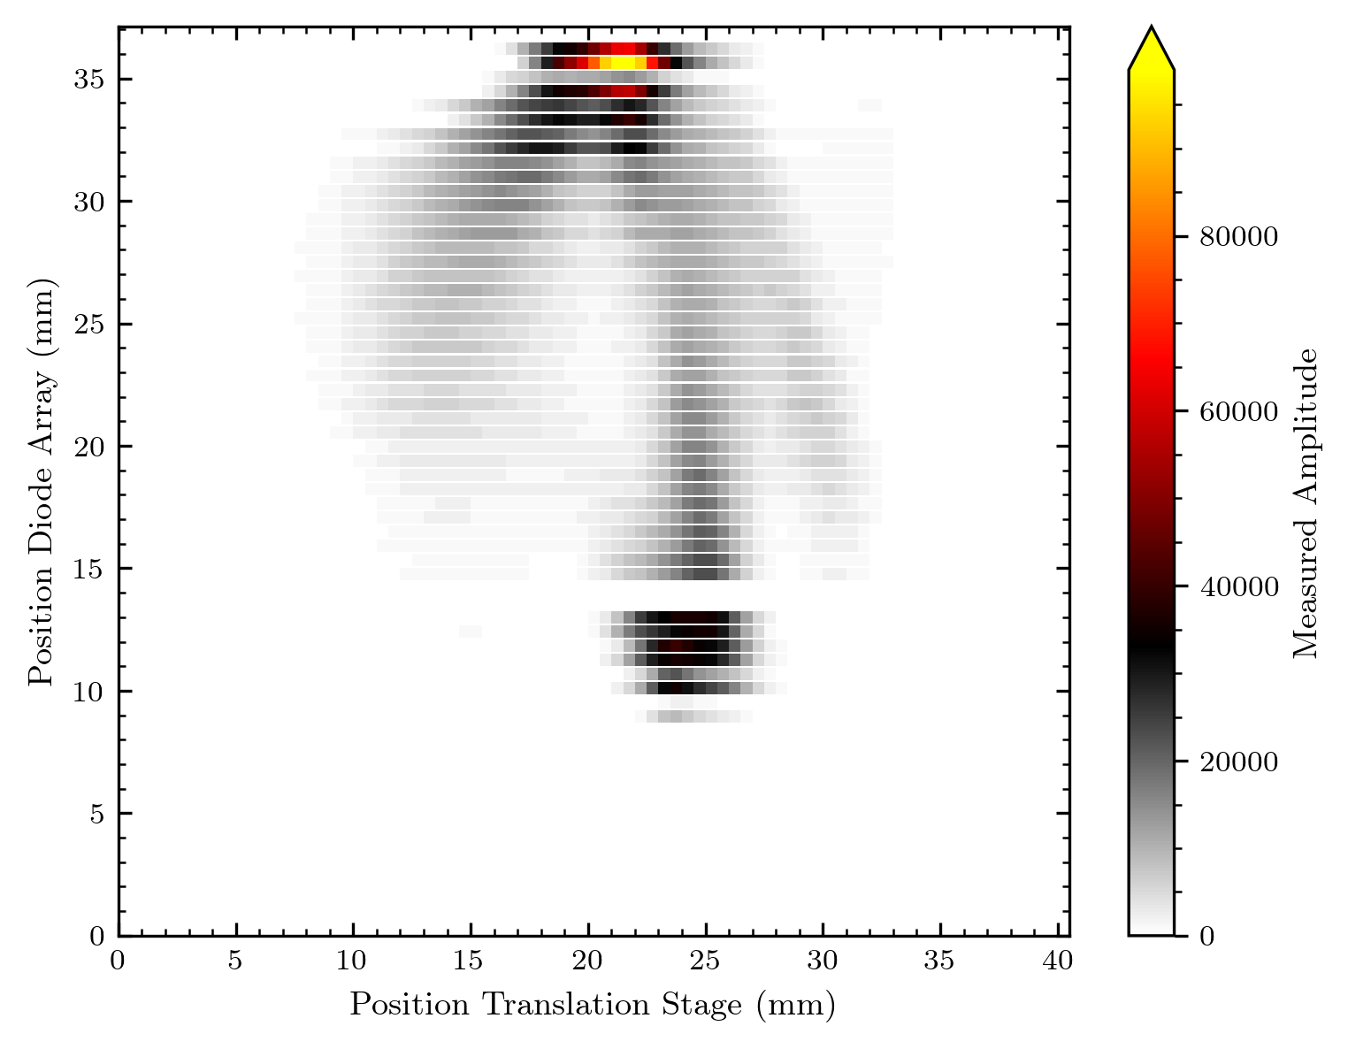
Beam without diffuser

Slide 38
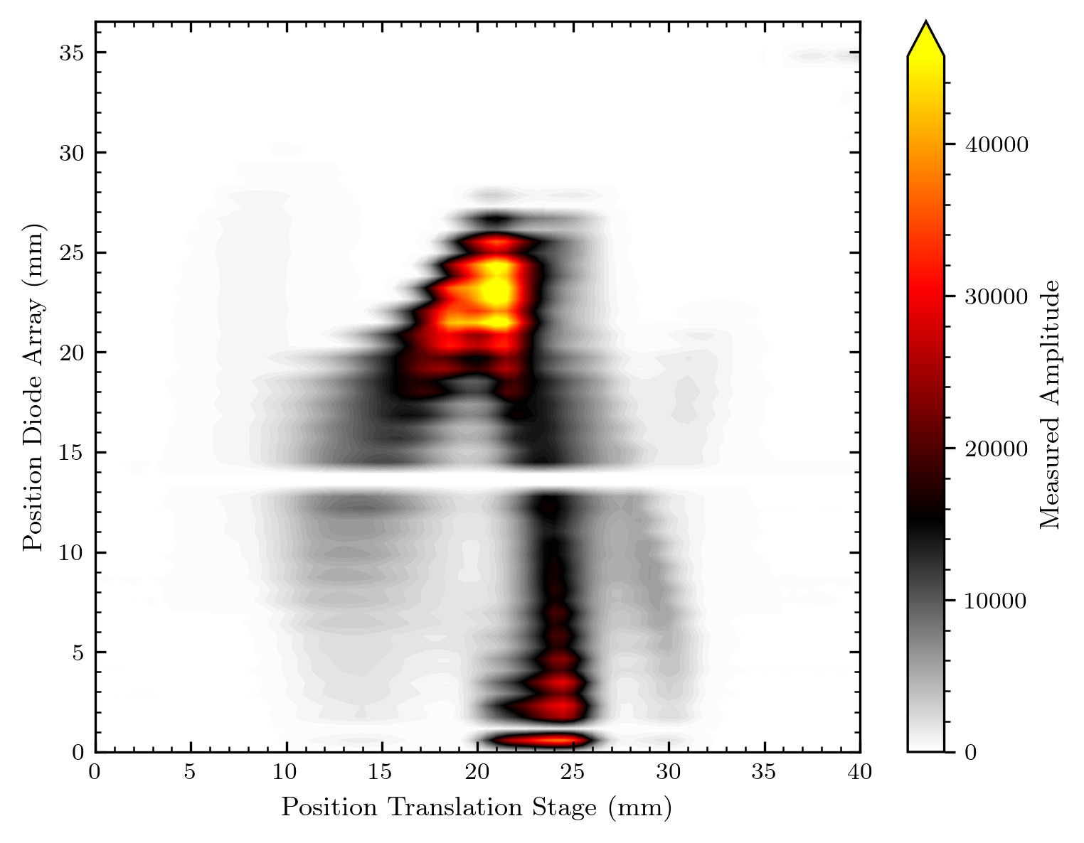
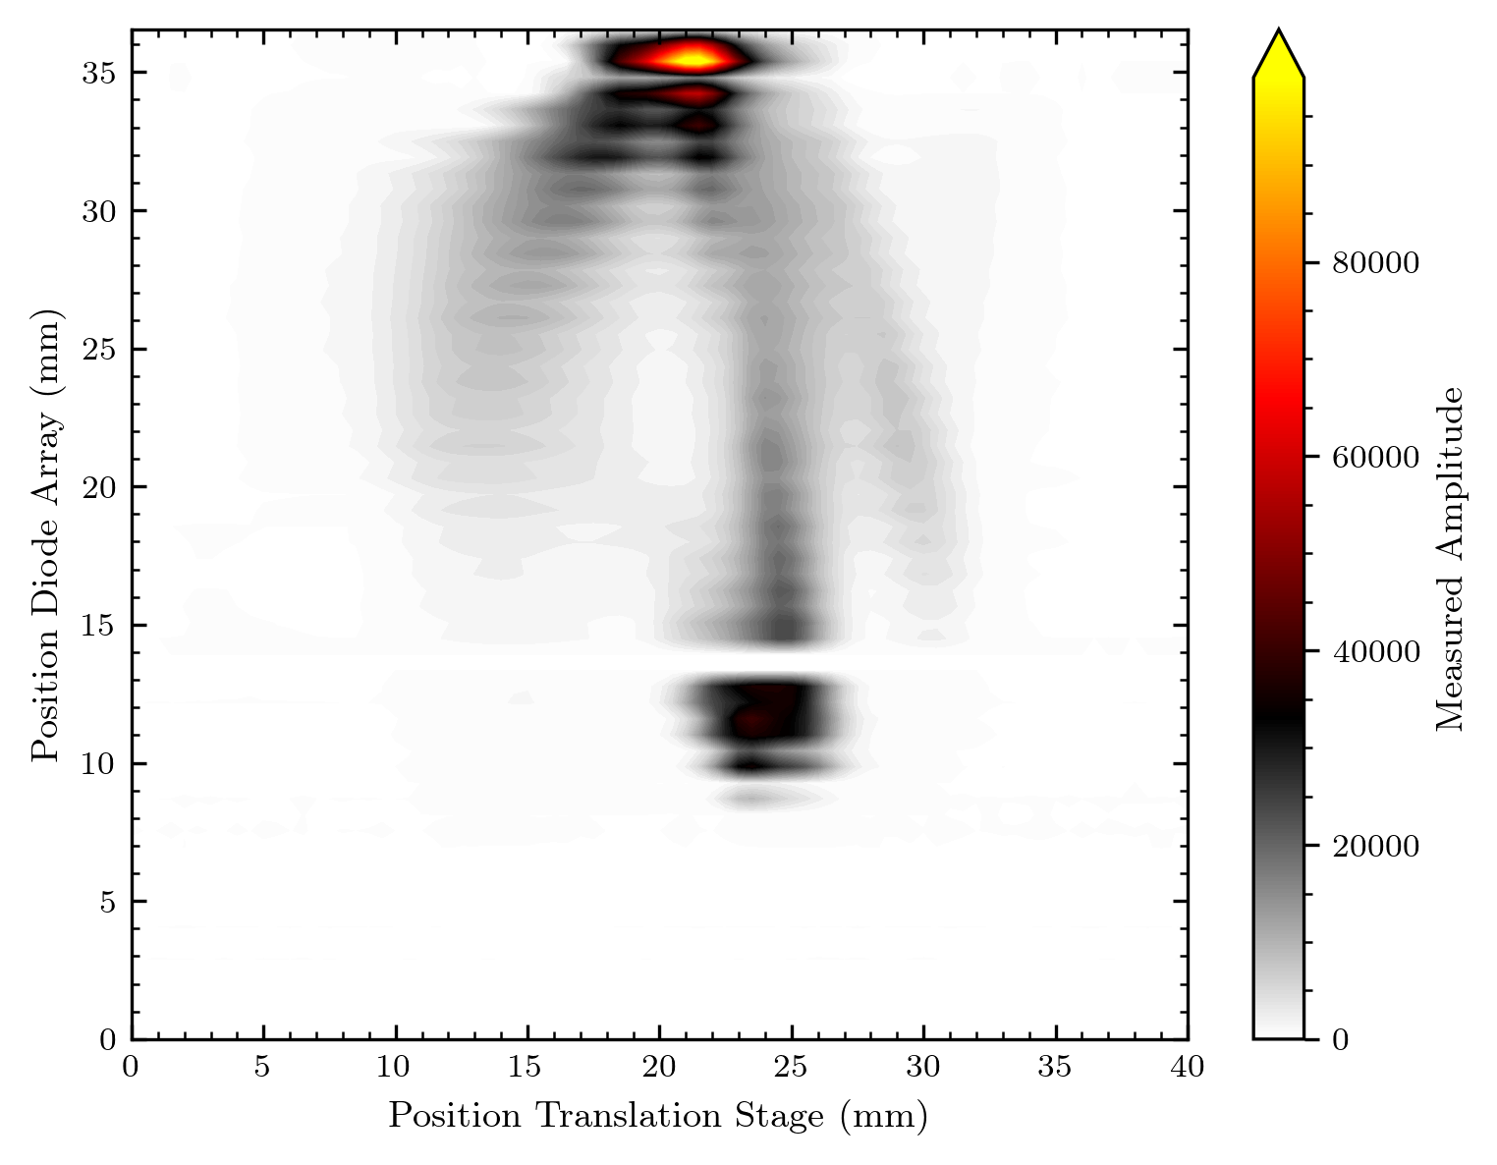
Beam without diffuser

Slide 39
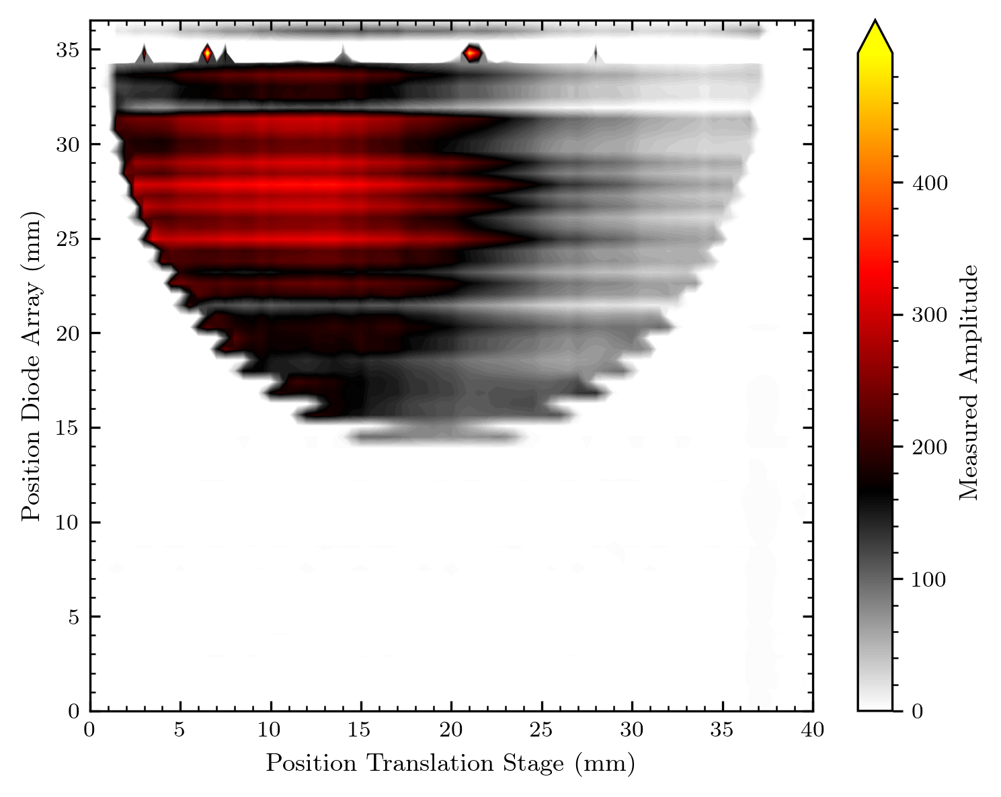
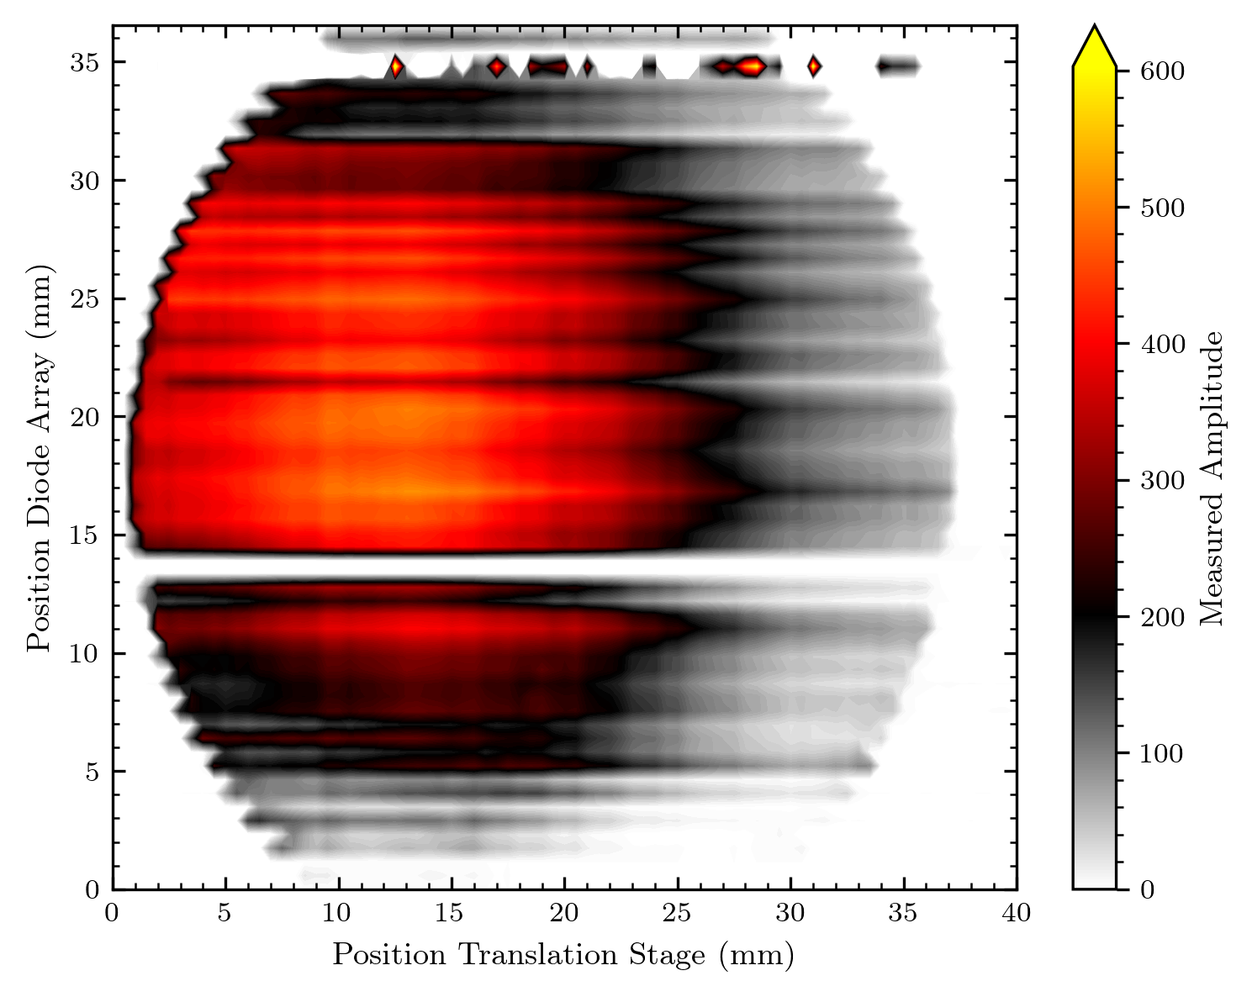
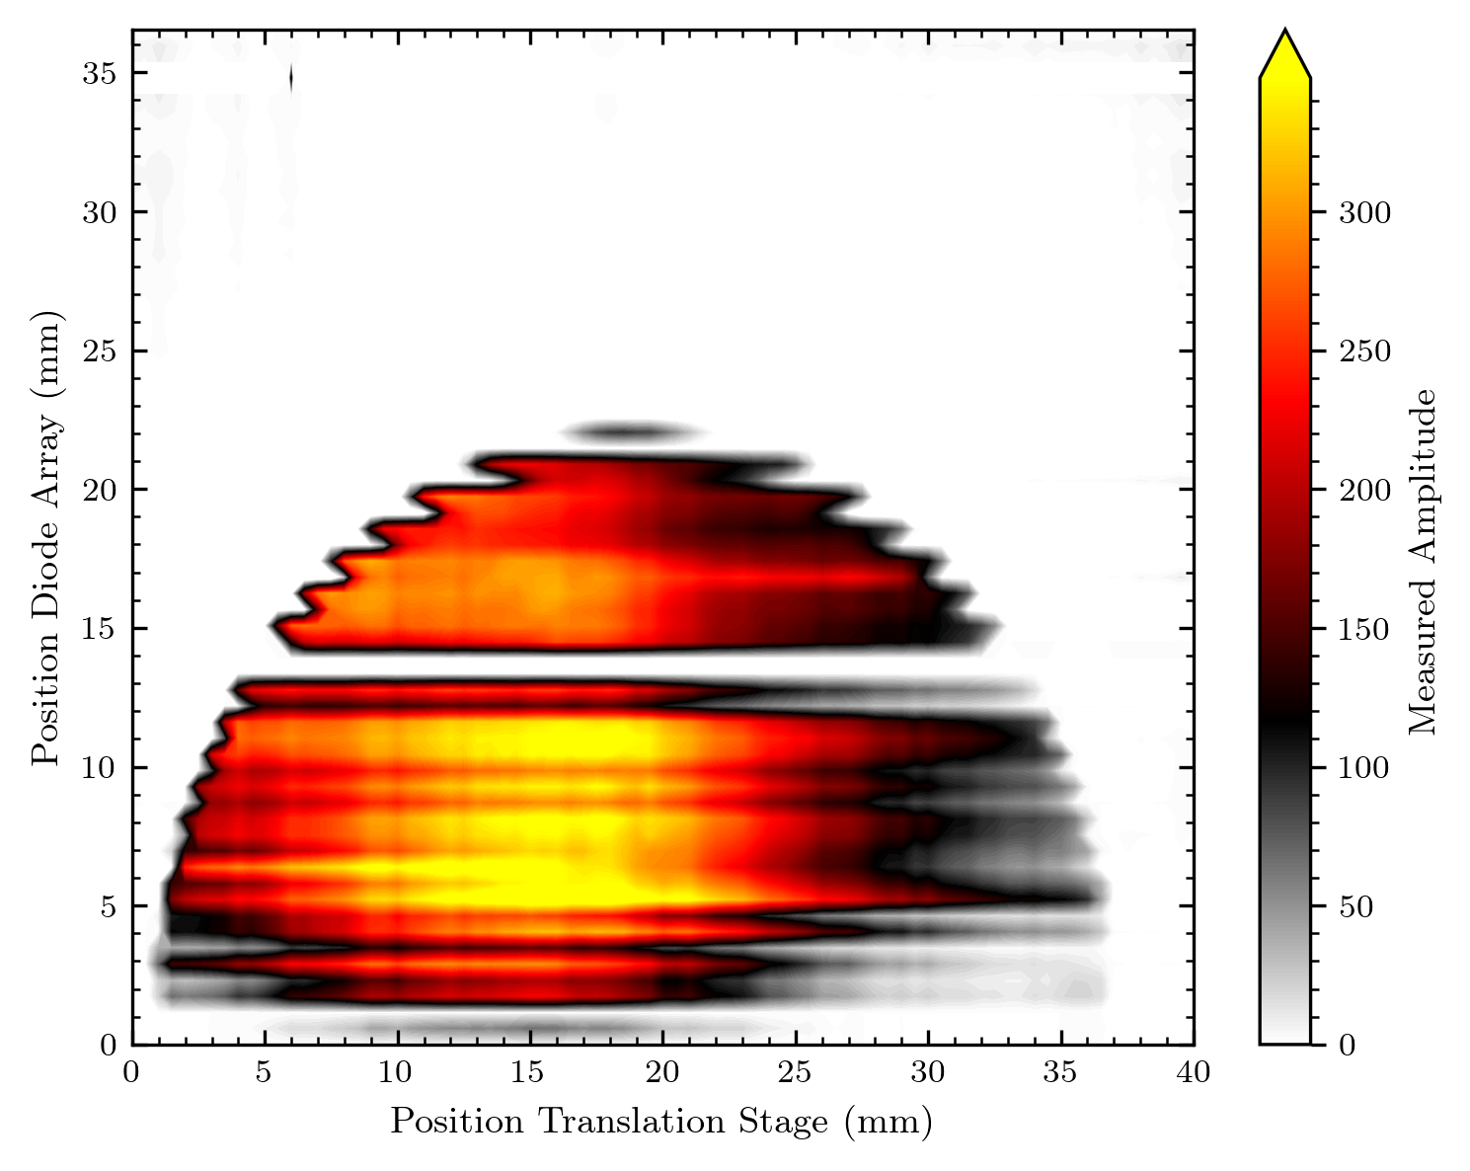
“Full scan“ 500pA with diffuser (and unstable beam?...)

Slide 40
Some remarks
I think there might be a differing beam shape behind the diffuser in the x-direction as in the y-direction
From the maps and beam_shape image I‘d say less intensity on the left side of images
From what I see on the pictures the objects seem to be resolved as expected

Slide 41
Some ideas for future measurements (if there are anymore with a 1D array)
More measurements at slightly shifted y-positions (e.g. to get a better result for the IPHC MATRIC CRHEA Logo)
Maybe an improved logo (clearer cutout in e.g. “I X“, shift towards Bragg peak for more signal?)
Curved shapes still strange resolved: Examine the impact of diode movement
Map something 2D so that a map out of one diode can be generated
Is this showing the same effect now also in the y direction?
(Also possible with rotated diode array)

Slide 42
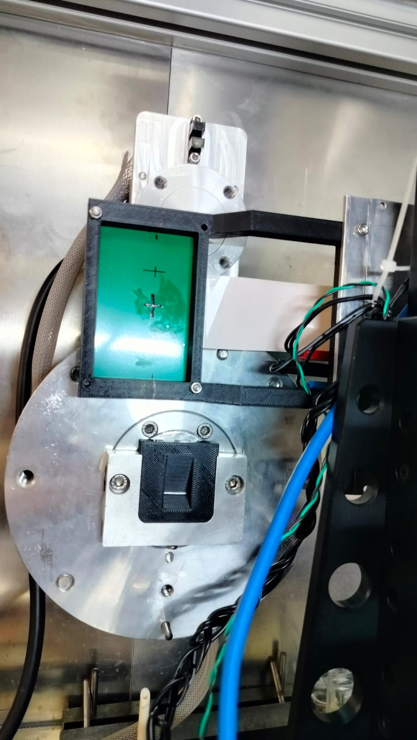
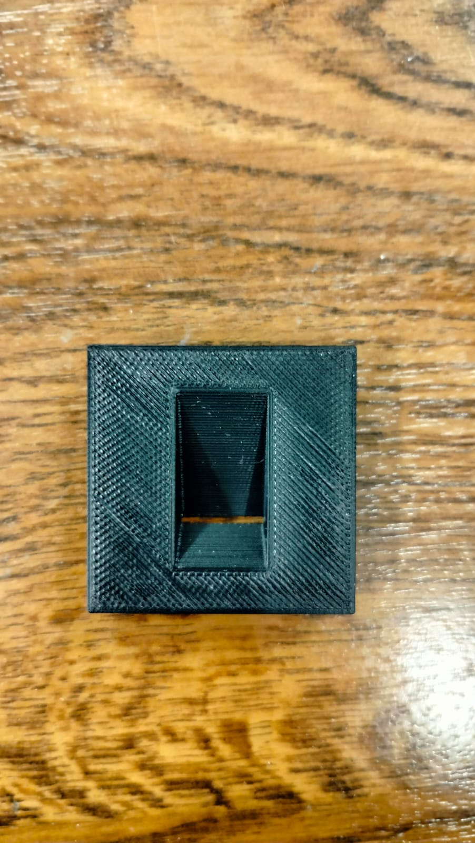
What‘s coming in the next days
Black trapeze to estimate Bragg peak (if i get the measures)
Change in software from script function approach probably into a class based approach for better handling (and easier modifications)
Software for 2D array measurments (maybe with interactive features so that its usable when we do the next measurements)

